Slide 1
Economic Update
& Sales Taxes
Donna K. Ginther
Roy A. Roberts Distinguished Professor of Economics
Director, Institute for Policy & Social Research, University of Kansas
Research Associate, National Bureau of Economic Research
November 19, 2020

Slide 2
Overview
COVID
Kansas Economy
Sales Taxes
Business Sales Taxes
Excise Taxes

Slide 3
COVID is Out of Control

Slide 4
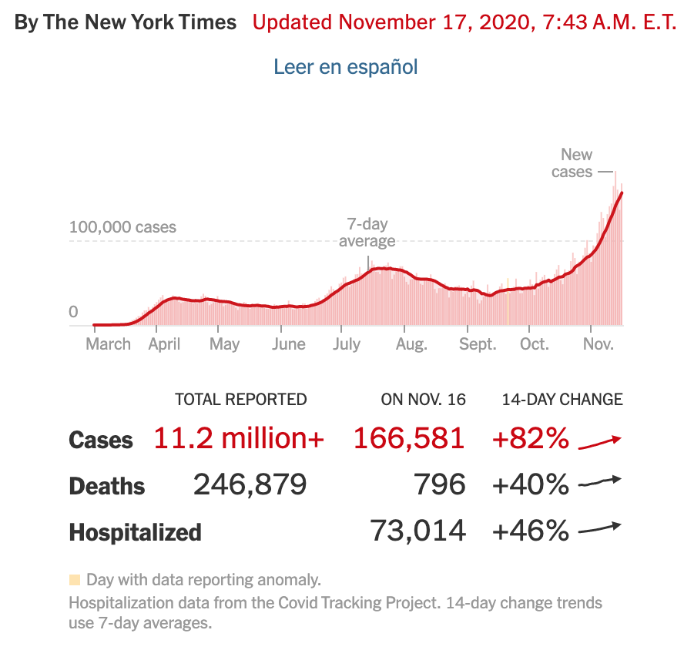
We have Exceeded 11 Million Cases & 250,000 Deaths
The past week we’ve averaged 155,442 cases per day.

Slide 5
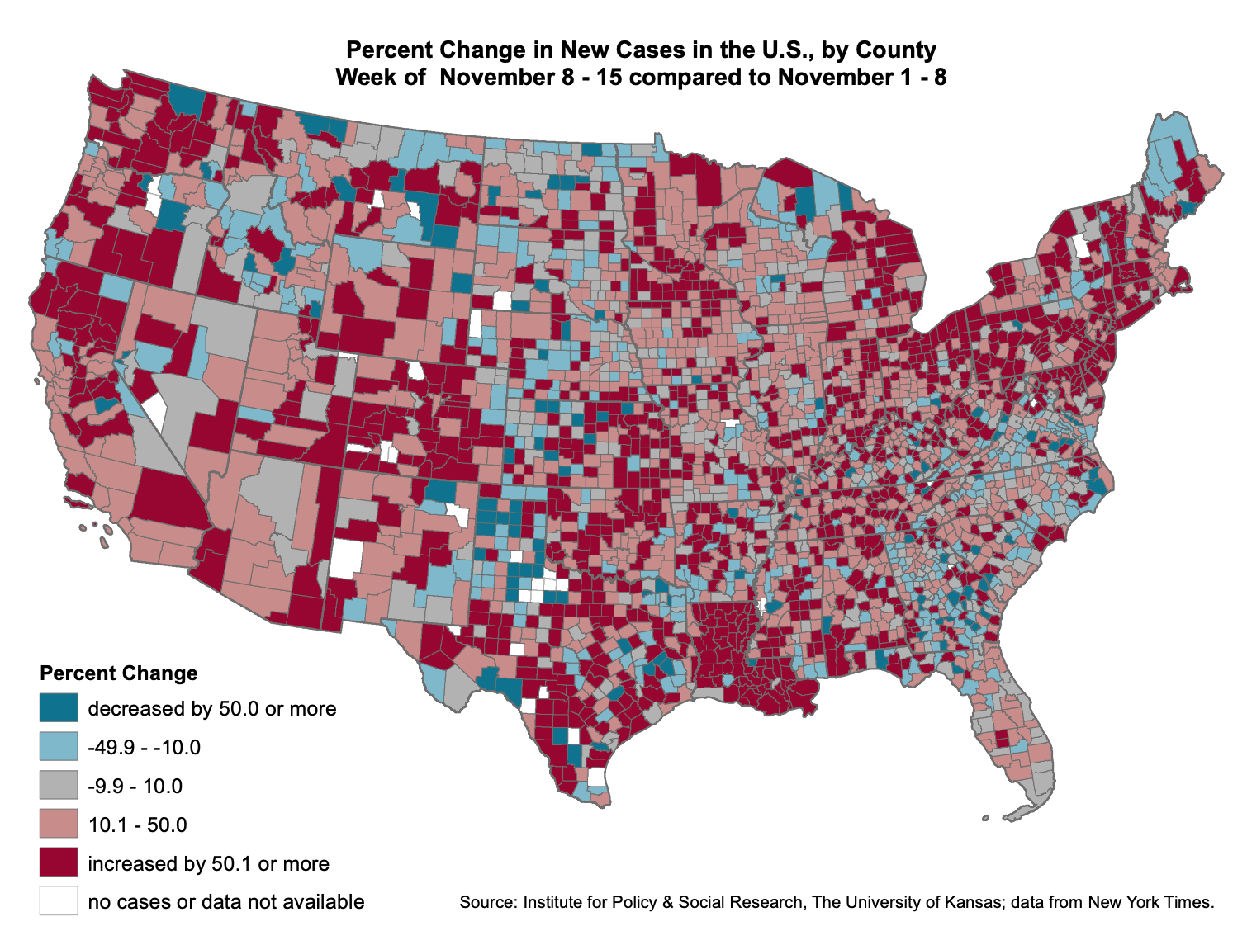
Covid Cases Concentrated in the Midwest
Map showing the increases in new cases by county between the weeks of November 15th and November 8th
Dark red counties indicate those that saw an increase of 50% or more
  There are a lot of red counties in Kansas

Slide 6
Troubling News: Kansas Daily Cases are Increasing
The 7-day moving average of new cases trended up in the past week.
Cases are increasing:
  Cases are forecast to fall but remain at a high level.

Slide 7
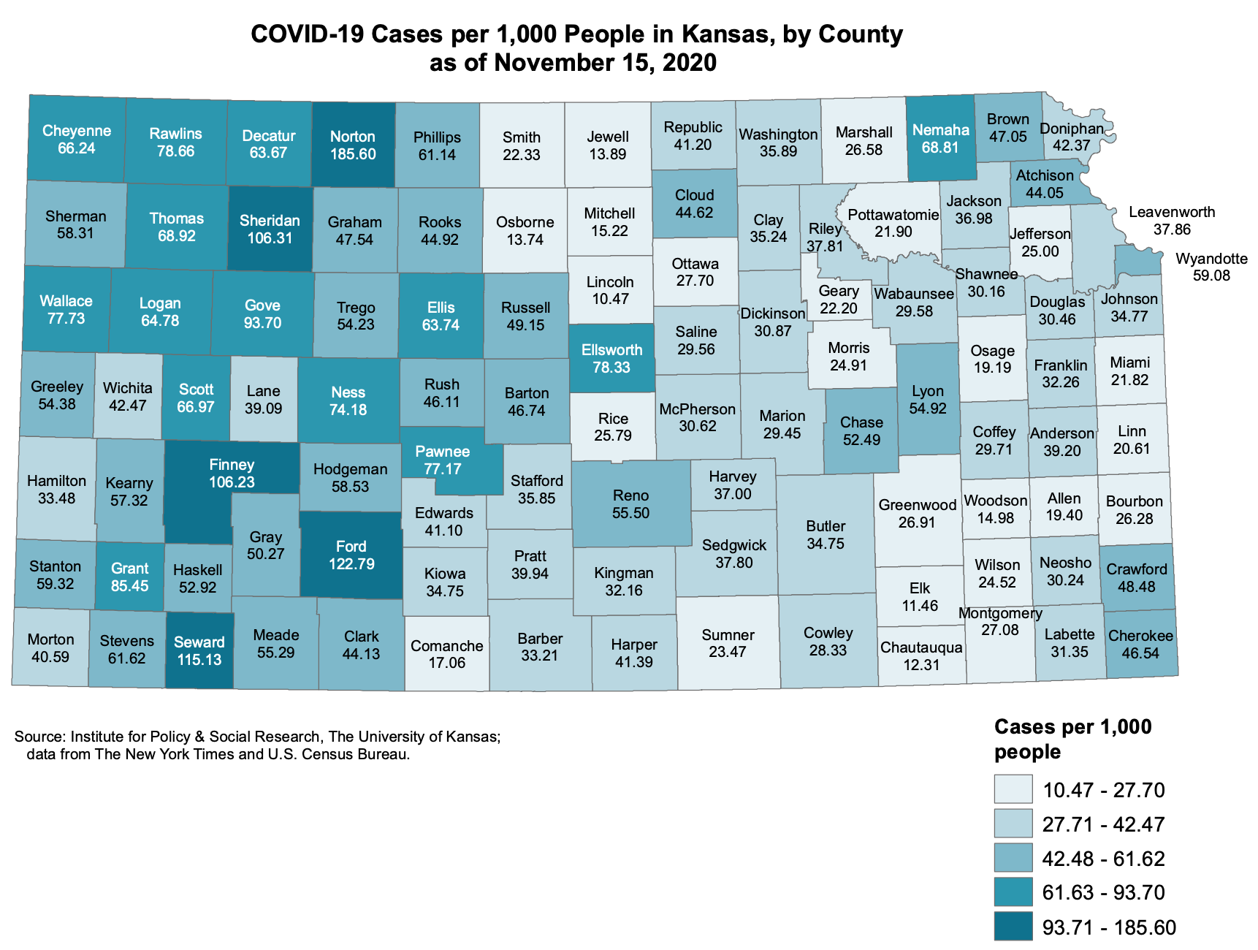
Case Rates by County
Darker colors indicate that these counties have higher case rates:
  Ford, Seward, and Finney Counties have case rates that are > 106 per 1,000
  Douglas, Sedgwick & Johnson Counties 30-37 per 1,000
  Leavenworth & Wyandotte Counties have case rates 38-59 per 1,000
Source: New York Times & US Census Bureau

Slide 8
Do Masks Work?
On July 3rd, the Governor implemented a mask mandate for the state of Kansas.
Counties could opt-out of the mandate.
Some cities imposed a mandate but the surrounding county did not
  Manhattan has a mandate but Riley County does not.
Source: IPSR

Slide 9
Do Masks Work?
Despite increasing spread of COVID across the state, case rates are significantly lower in mask counties.
Our estimates show that Mask counties have a 60% reduction in cases per day.
Source: IPSR

Slide 10
The Economic Recovery Has Stalled

Slide 11
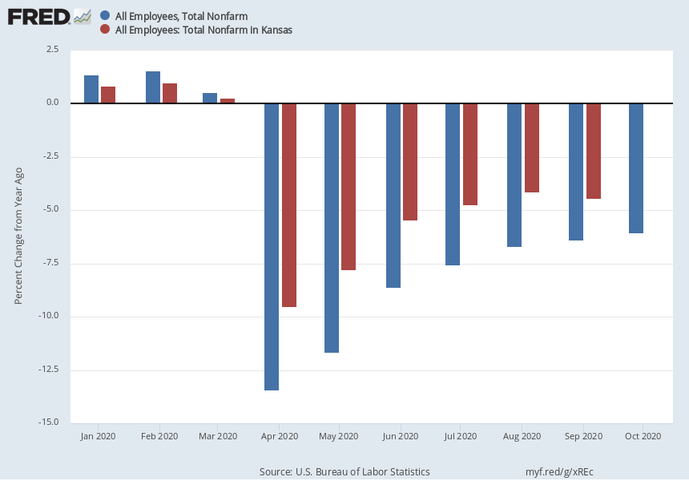
Employment in Kansas and the US
Kansas Employment was down 4.4% from a year ago in September.
US Employment down 6% compared to a year ago in October.
Employment recovery has stalled.

Slide 12
Unemployment Claims in Kansas and Missouri
15,009 people filed an initial claim in Kansas the week of November 7th
Since March 14th a total of 555,046 workers have filed initial unemployment claims in Kansas.
Initial claims remain stubbornly high.
  Data from March 14th – November 7th
Source: Calculations using KS and MO Department of Labor Data

Slide 13
Cumulative Initial Unemployment Claims by Industry
Industries hardest hit include:
  Manufacturing: 116,977
  Accommodation & Food Services: 70,170
  Health care & Social assistance: 53,498
  Retail Trade: 56,449
  Other Services: 37,675
These five industries account for 60% of people who have lost their jobs.
Source: Calculations using KS and MO Department of Labor Data

Slide 14
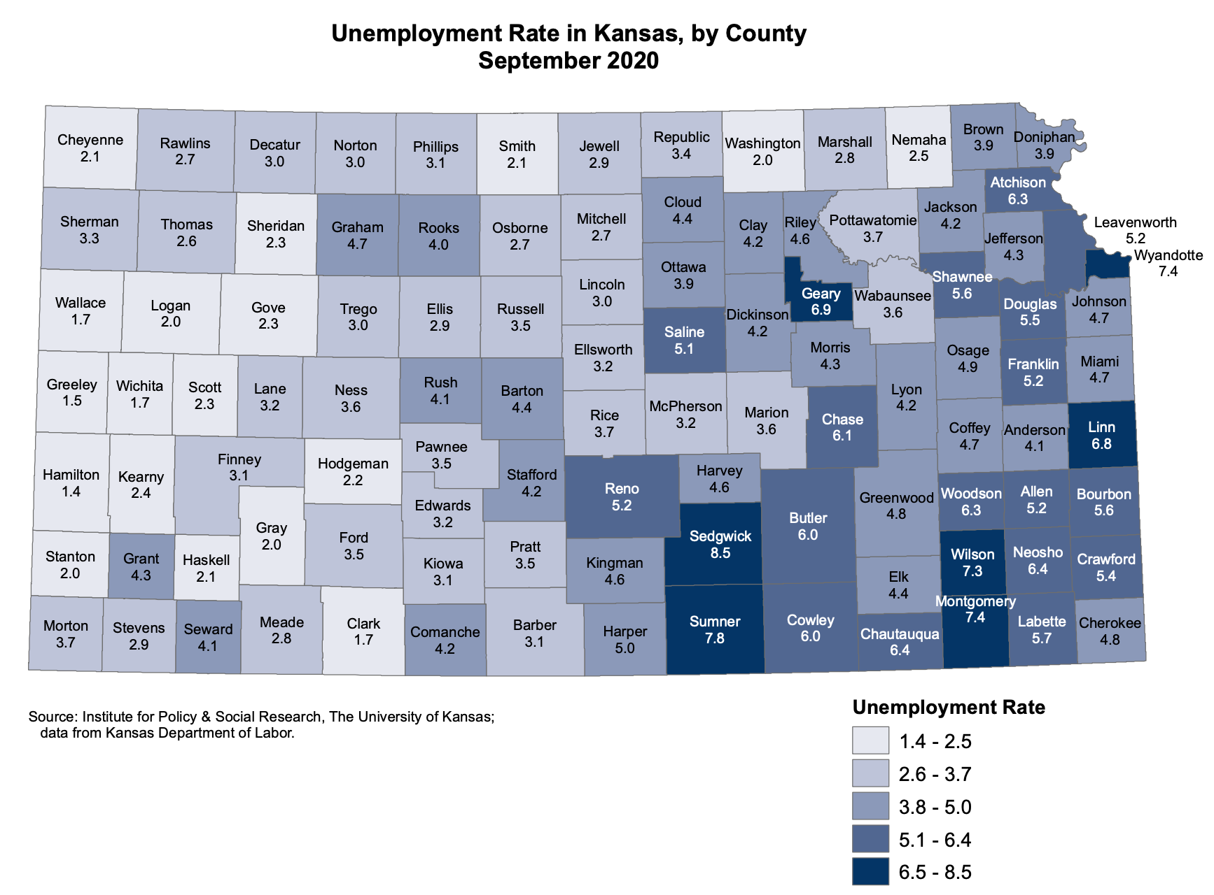
September Kansas Unemployment Rate 5.9%
Uneven impact across the state:
  Sedgwick County 8.5%
  Douglas 5.5%
  Johnson 4.7%
  Wyandotte 7.4%
  Shawnee 5.6%
Eastern half of the state is suffering
Source: IPSR calculations using Kansas Department of Labor Data

Slide 15
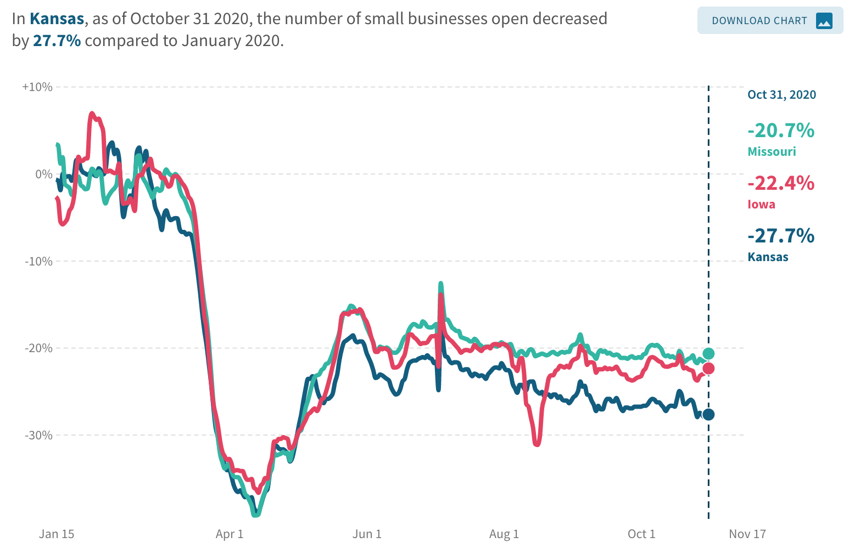
Kansas Small Businesses are Less Likely to be Open
The number of small businesses open in Kansas has fallen by 27.7% since January.
  In the US, the number is –24.2%
  Kansas is doing worse than Missouri -20.7%
  and Iowa -22.4%
Small businesses being open have dropped since July.
Source: Economic Tracker
https://tracktherecovery.org/

Slide 16
Kansas and US Household Comparison
39% of households faced loss in Employment income in the week of October 14th-26th
  50% of households with children report likely or somewhat likely eviction
  12% of households with children are food insecure

Slide 17
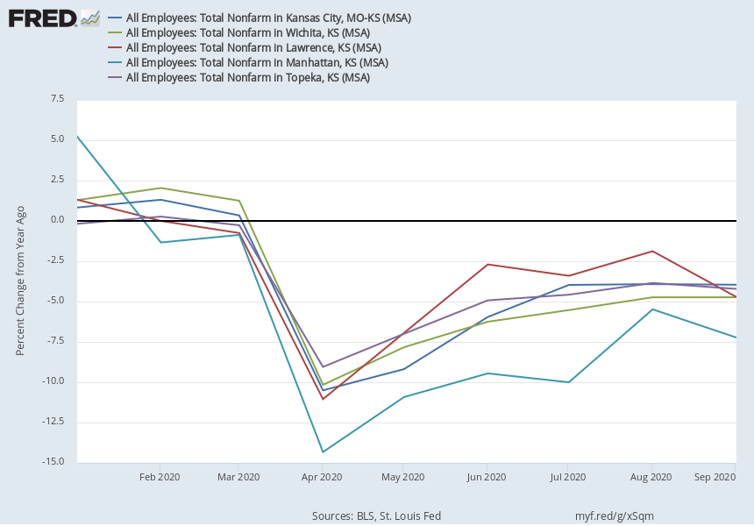
Employment by Major City in Kansas
Kansas City MSA down 3.9% from a year ago.
Wichita down 4.7%.
Lawrence down 4.7%.
Manhattan down 7.2%.
Topeka down 4.2%.

Slide 18
Is this a K-shaped Recovery?
August 13, 2020
Source: https://www.washingtonpost.com/business/2020/08/13/recession-is-over-rich-working-class-is-far-recovered/?utm_campaign=wp_post_most&utm_medium=email&utm_source=newsletter&wpisrc=nl_most

Slide 19
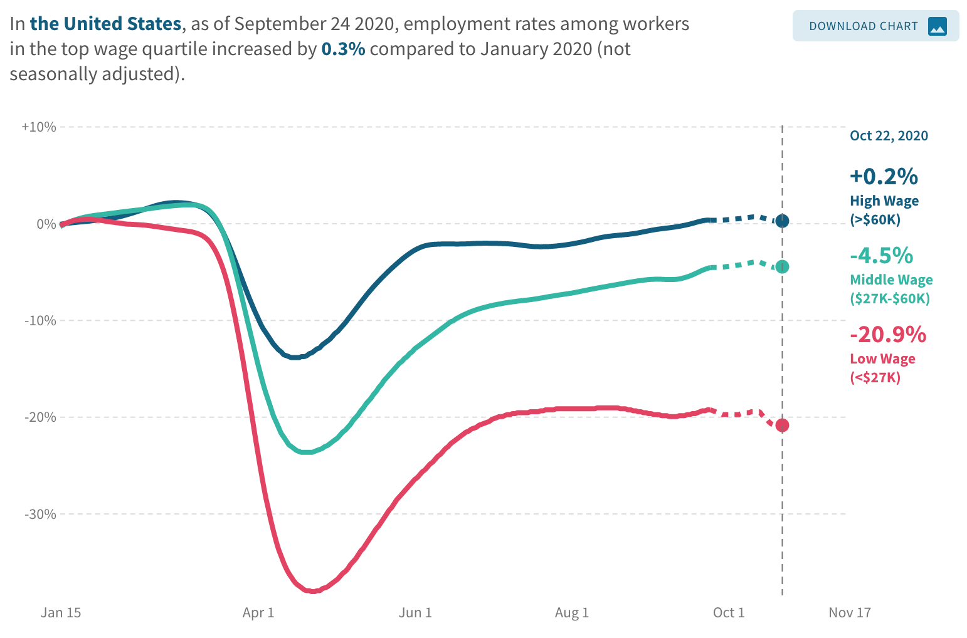
Is this a K-shaped Recovery?
Jobs for those earning > $60,000 per year are up .2%
Jobs for low wage workers, earning <$27,000 per year are down 20.9%
  The rich have recovered.
  The rest have not.

Slide 20
Is this a K-shaped Recovery in Kansas?
Jobs for those earning > $60,000 per year are down -2.9%
Jobs for low wage workers, earning <$27,000 per year are down 14.7%
  The rich have recovered.
  The rest have not.

Slide 21
Could the K turn into a W?
The Fed chair, Jerome H. Powell said: “Too little support would lead to a weak recovery, creating unnecessary hardship for households and businesses,” he said. “Over time, household insolvencies and business bankruptcies would rise, harming the productive capacity of the economy and holding back wage growth.”
Source: October 7, 2020 New York Times. https://www.nytimes.com/2020/10/07
/business/second-stimulus-bill-fails-impact.html?action=click&module=Top%20Stories&pgtype=Homepage

Slide 22
Sales Taxes are High in Kansas

Slide 23
Kansas has High Sales Taxes
According to the Tax Foundation, Kansas combined sales taxes are the eighth highest in the country.
Only Oklahoma has higher sales taxes in our region.

Slide 24
Nevertheless, Sales Taxes are one of the shorter legs on the three-legged stool
In FY 2019:
Income taxes 26.5%
Sales taxes 28%
Property taxes 34.3% of tax revenues.

Slide 25
How Does Kansas Compare to Other States?
Sales Tax Revenue

Slide 26
State and Local Sales Tax Rates
Kansas state-level rates are the highest in the region.
Combined state and average local rates are second highest, after Oklahoma, which relies extensively on local sales taxes.

Slide 27
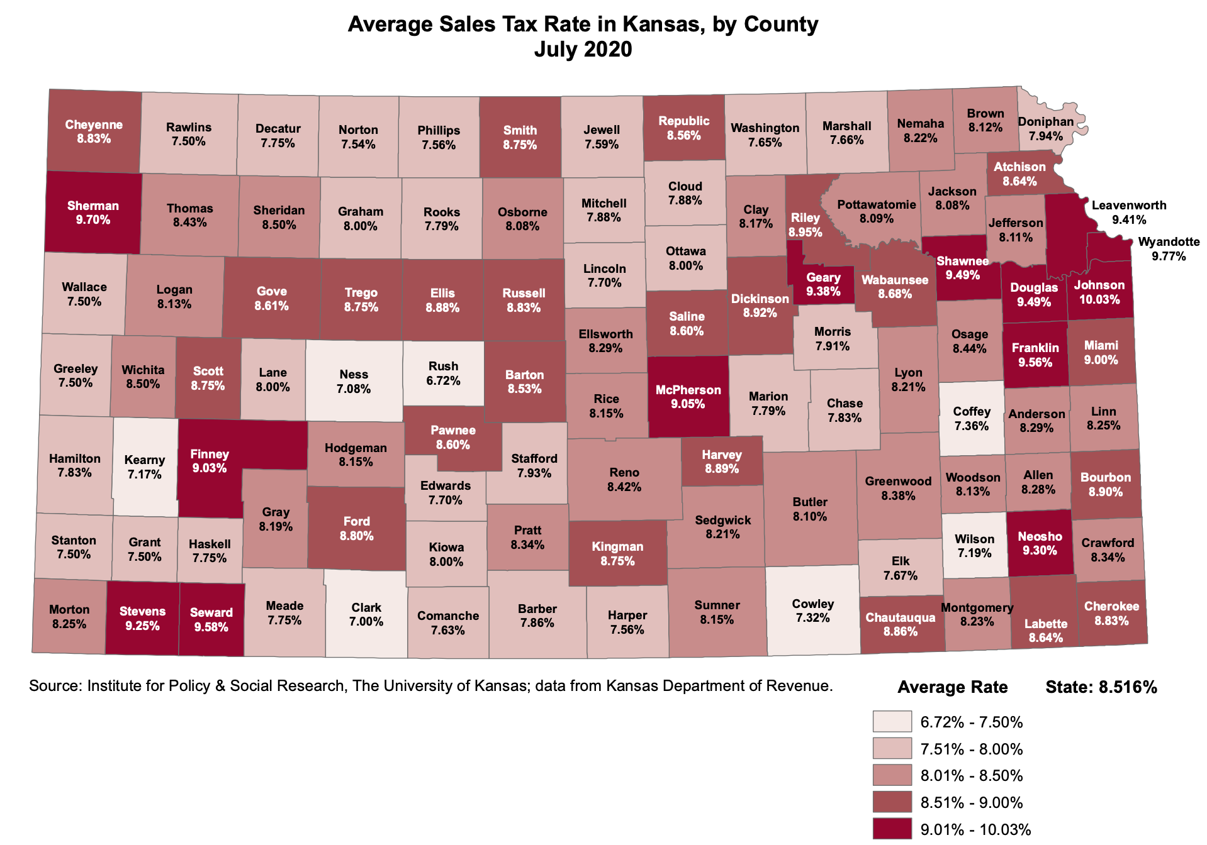
Average Sales Tax Rates by County
Highest in:
  Johnson: 10.03%
  Wyandotte: 9.77%
  Sherman: 9.70%
  Seward: 9.58%
  Douglas: 9.49%

Slide 28
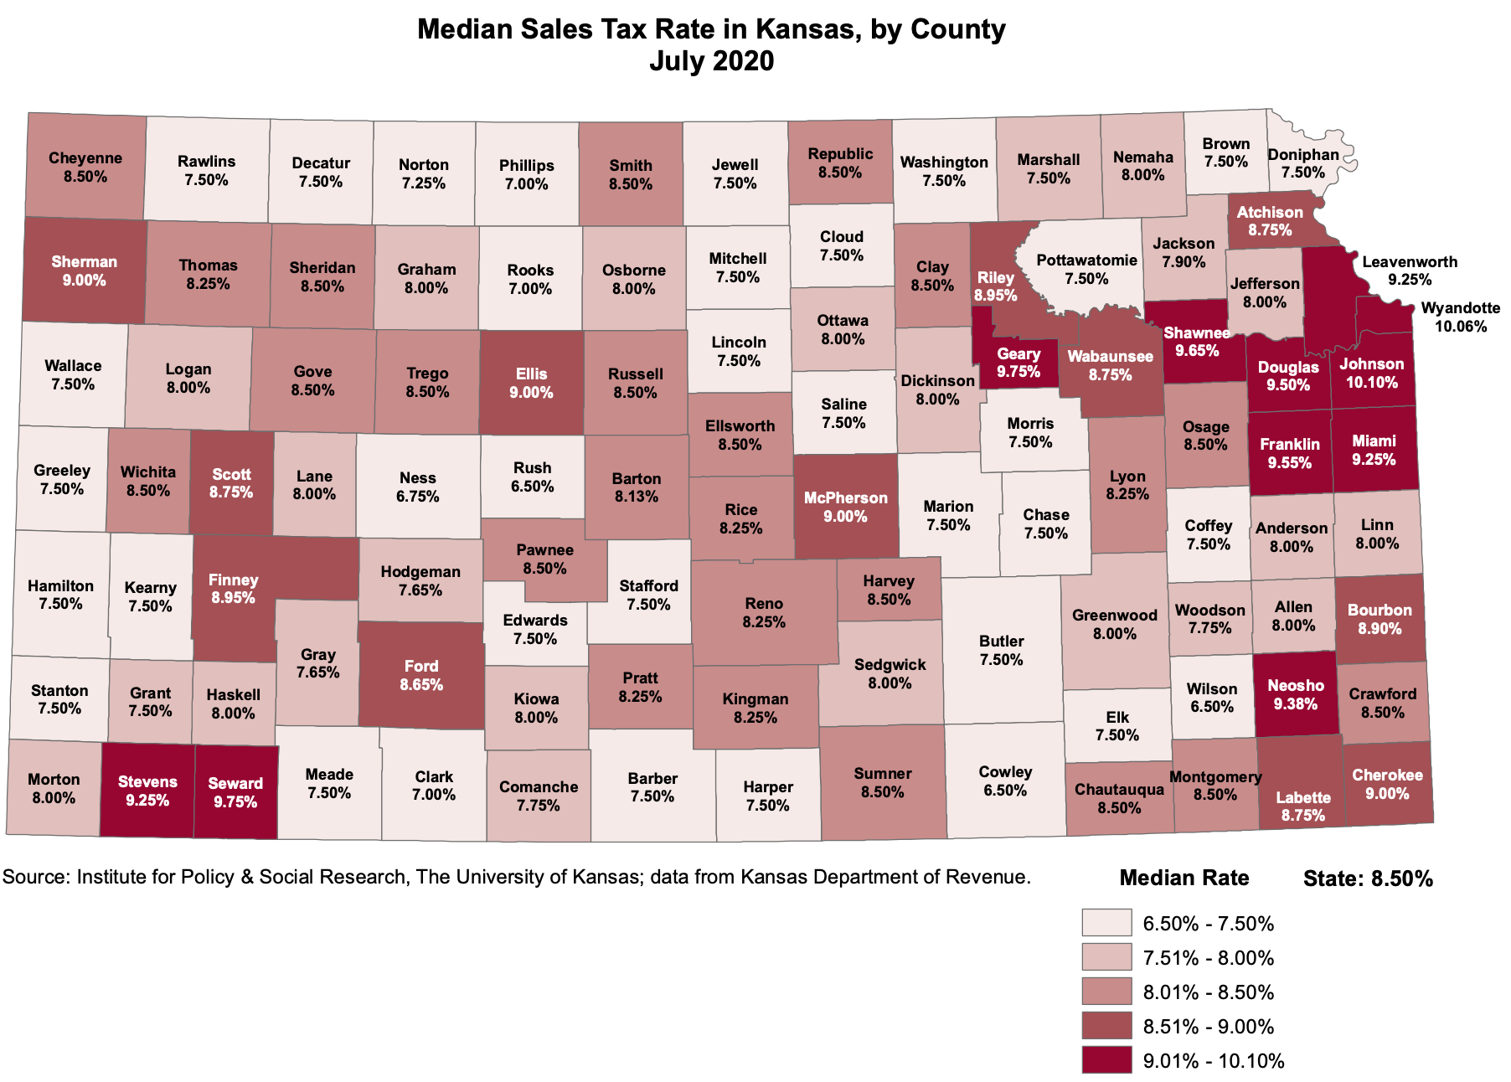
Median Sales Tax Rates By County
Highest in:
  Johnson: 10.10%
  Wyandotte: 10.06%
  Geary: 9.75%
  Seward: 9.75%
  Shawnee: 9.65%

Slide 29
State Sales Tax as a Share of Total State Tax Revenue
One-third of total state-level taxes in Kansas come from sales taxes.
This is much higher than in the US & comparison states.

Slide 30
State Sales Tax as a Share of Total State Tax Revenue
Starting in 2011, state-level sales taxes as a share of total revenue grew relative to the US and comparison states.

Slide 31
State and Local Sales Tax Revenue Per Capita
The states in the region differ widely in the in their overall reliance on the sales tax and on the division of tax collections between state and local governments.
74% of per capita sales tax revenue goes to the state.

Slide 32
State and Local Sales Tax Revenue as a Share of Personal Income
Sales taxes in Kansas take a greater share of income than they do in the rest of the region.
3.1% of personal income is paid in sales taxes
  2.3% paid to the state

Slide 33
State Sales Tax as a Share of Personal Income
The same story holds when we look just at state-level sales taxes.
Kansans pay the highest share of personal income in sales taxes in the region.

Slide 34
State Sales Tax Revenue as a Share of Personal Income
Kansas has received a higher share of sales taxes as a percentage of personal income compared to the US and surrounding states.
  This difference became larger starting in 2011

Slide 35
State Sales Tax Per Capita
Kansas has above average state sales taxes per capita compared to the US average and surrounding states.

Slide 36
Local Sales Tax Revenue as a Share of Personal Income
Kansas pays a lower share of local tax compared to surrounding states.
However Kansas pays higher local taxes than the US average.

Slide 37
Local Sales Tax Per Capita
Kansas local sales tax per capita has increased rapidly since 2010.
It is converging to the higher rates in comparison states.

Slide 38
Recent Sales Tax Collections by State
Sales taxes fell between April and July compared to the previous year and as a result of COVID.
  Nebraska was the only state to have an increase.
  Kansas did better than other states that experienced a decline.

Slide 39
Sales Tax Regressivity

Slide 40
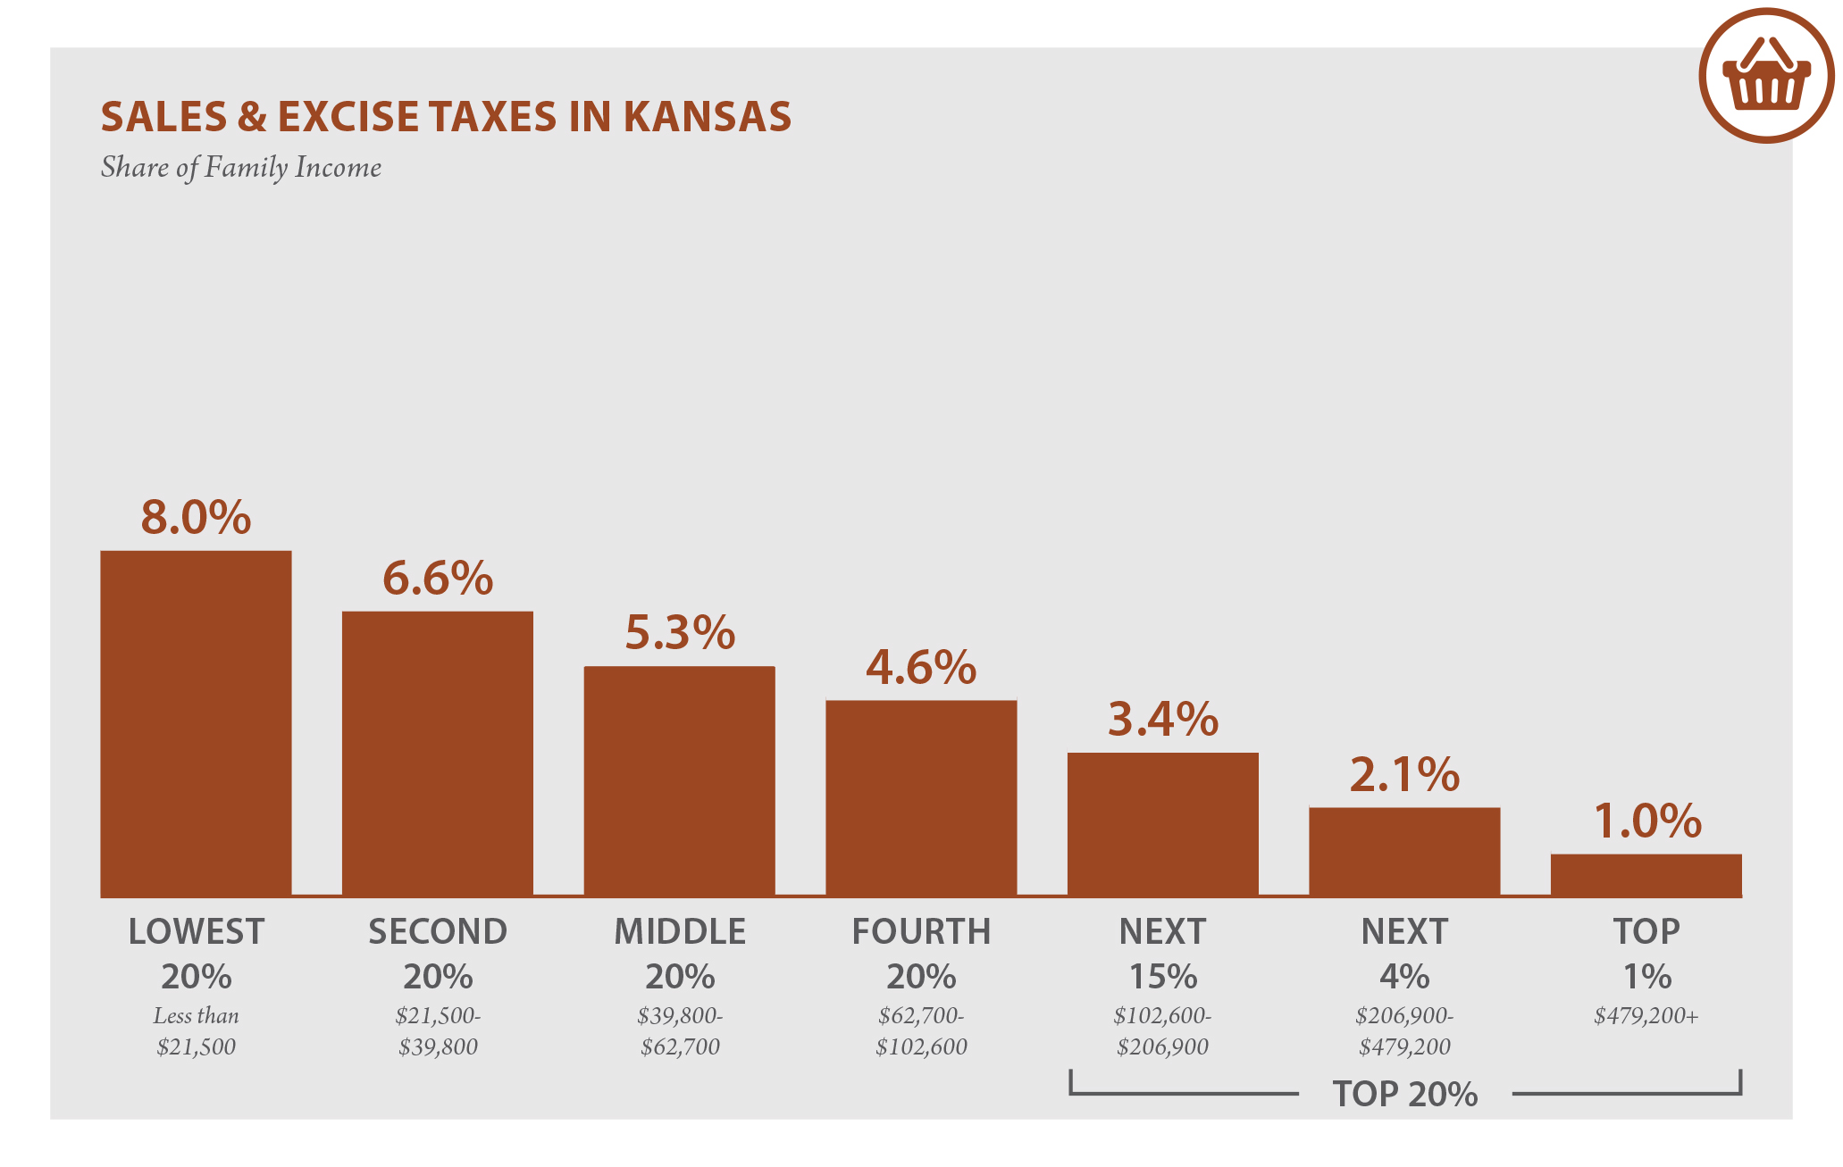
Sales Taxes Are Regressive
Analysis by ITEP (2018) shows that in Kansas, low income households pay a higher share of income in sales taxes than higher income households.

Slide 41
Low Income vs High Income Household Spending in Relation to Income
Sales taxes on almost all goods and services are regressive, because low-income households spend a higher percentage of their income than do high income households.
However regressivity varies by type of expenditure.
The chart compares spending of households in the third decile of income with those in the 9th decile.
Taxes on items with higher ratios are more regressive.
Calculated as (low income HH share) / high income HH share).
Data taken from consumer expenditure survey.

Slide 42
Sales Tax on Food Consumed at Home, 2020
Kansas is one of the few states in the country that taxes food at the full rate.
Oklahoma also taxes food and Missouri taxes food at a low rate.
Colorado and Iowa tax candy & soda.

Slide 43
Cutting Food Sales Taxes May not be the Answer
Using hypothetical taxpayers and food consumption behavior, a 3% cut in food sales taxes would provide:
  $81.75 per year to a single person earning $23,000
  $183.69 to a Married household with one child earning $125,000

Slide 44
Sales Tax Base
Keeps Shrinking

Slide 45
Services as a Share of US Personal Consumption Expenditures
Services now make up over two-thirds of consumption expenditures (an increase from 64% in 2000)
To the extent that services are not taxed, the sales tax base is eroding.

Slide 46
Ratio of Taxable Sales to Personal Income
Taxable sales estimated as annual state-level sales tax collections / sales tax rate.
The ratio has declined fairly steadily.
States such as Kansas have raised rates to maintain revenue.
Kansas maintained a higher ratio of taxable sales than other states in the region historically, but recently the ratio has converged to the regional average.

Slide 47
Per Capita Income and Per Capita Taxable Sales
The Kansas sales tax is inelastic, as are sales taxes throughout the region.
Real personal income per capita has grown while real taxable sales per capita have stayed fairly constant.

Slide 48
Number of Services Subject to State Sales Tax, 2017. Kansas and Region
Kansas taxes more services than Colorado, Oklahoma, and Missouri, but far fewer services than Iowa.

Slide 49
Number of Services Subject to State Sales Tax, 2017. Selected States Outside Region.
Outside of our region, Kansas taxes far fewer services.
These states tax:
  Twice the number of personal services
  Three times the number of business services
  As well as professional services.

Slide 50
Sales Taxes on Specific Digital Goods and Services
A recent study found that digital goods and services accounted for nearly three-quarters of online purchases worldwide.
Kansas currently taxes only one of eight digital services.
29 states tax at least two services.
Only Oklahoma taxes fewer digital goods
An unsuccessful proposal to tax digital goods was introduced in the 2019

Slide 51
Sales Taxes on Specific Digital Goods and Services continued
Items to be taxed included: digital audio-visual works, digital audio works, digital books, artwork, digital photos and pictures, periodicals, newspapers, magazines, video, audio and other greeting cards, graphics, templates, , patterns, desktop applications, mobile applications, web applications, cloud based applications, native applications, online games, video games, electronic games, and any digital code related to any of the above items and any streaming services related to the above items.
A fiscal note on the proposal indicated that fully taxing digital goods would raise between 45-$50 million annually.
Some states tax digital goods if an alternative physical form of the good is available and if the alternative is taxed (Texas)
A May, 2020 proposal by the Colorado DOR defined items as taxable regardless of mode of delivery, making the items "tangible personal property" and hence taxable.
Rhode Island added software and streaming services to its sales tax base in June 2020.
Effective in 2019, Iowa extended the sales tax to software and many other digital goods and services.

Slide 52
Wayfair Provisions in Kansas and Comparison States
In June 2018, The US Supreme Court ruled that out-of-state businesses without a physical presence in a state could still be required to collect sales taxes from in-state customers. (South Dakota v. Wayfair Inc.)
The SD law contained a provision that a remote business have $100,000 in sales or 200 transactions in the state before sales taxes became applicable.
Many states have adopted the SD provision or a variation. However, the Supreme Court did not rule specifically that this provision was necessary.
Kansas is unique in not specifying minimum thresholds for applying the sales tax to out-of-state sellers.

Slide 53
Marketplace Facilitator Laws
Kansas is one of only three states that collects sales taxes and has no marketplace facilitator law.

Slide 54
Taxing Services is Difficult
Several states have attempted to "modernize" their sales tax bases. Most of these efforts have been unsuccessful.
Comprehensive tax reform was introduced in Utah in 2019. The sales tax base would have expanded to include most services, while the rate would have been reduced. The measure passed and then was rescinded a month later.
Two pieces of legislation were introduced in Maryland in 2020. The first, which died in subcommittee, would have expanded the sales tax to many professional services. The second would have taxed "luxury services" such as jewelry repair, boat repair, and golf club memberships. The second measure passed in both the Maryland House and Senate.

Slide 55
Taxing Services is Difficult
Legislation was introduced in Nebraska (2020) to tax all services not exempted explicitly and to lower the sales tax rate. the bill has been "indefinitely postponed."
Two states have taken measures to PREVENT modernization of their tax bases by taxation of services.
  1) Missouri voters, in 2016, passed a constitutional amendment prohibiting taxation of additional services that were not already taxed in the state.
  2) Arizona voters approved a similar constitutional amendment by a 2 to 1 vote in 2018.

Slide 56
Conclusions
Kansas has relatively higher state sales taxes and relatively lower local sales taxes compared to surrounding states.
  State and local taxes combined, Kansas has the highest per capita sales tax burden in the region
Sales taxes are regressive and Kansas taxes groceries at the full rate.
  However cutting grocery sales taxes may not solve the problem because more money would accrue to higher income households.

Slide 57
Conclusions
Services make up over two-thirds of consumption expenditures.
Ratio of taxable sales to personal income has fallen
  Sales tax is inelastic.
Although Kansas taxes more services than many surrounding states, its service sales tax base is much narrower than states outside our region.
Taxing digital goods would add $45-$55 million annually to state revenues

Slide 58
Sales Taxes on Inputs
Kansas and Comparison States

Slide 59
Sales Tax Paid on Business Inputs
Ernst and Young performed a study of business sales taxes for the State Tax Research Institute and COST (Council on State Taxation) (2019).
EY created a model to estimate the share of sales taxes due to business inputs. Kansas is in the middle.
The EY model also estimates the percentage of business inputs that are taxable. Kansas appears to be at the low-end.
All of the states in the region provide substantial sales tax exemptions for business inputs, especially for manufacturing.

Slide 60
Sales Tax Exemptions for Machinery and Equipment
State and local exemptions for business machinery and equipment are prevalent in region.
All of the states exempt M&E for manufacturing, although the scope of the exemption varies.
Several states exempt M&E for mining activities.
Additionally, all the states in the region exempt agricultural M&E.

Slide 61
Sales Tax Exemptions for Industrial Utilities Usage
States in the region employ broad exemptions for utilities used in manufacturing and agriculture. Most, including Kansas, exempt use in mining.
The exact calculation of the percentage of utilities exempted varies by state.
In Colorado and Missouri, utilities used in manufacturing and other industries may be taxed at the local level.
In addition, ingredients and components of manufactured products are exempt in the states in our region, although definitions may vary.

Slide 62
Application of sales tax to business inputs
Argument
Counter-argument
Sales tax should be a tax on final consumption of households.
Sales taxes on business inputs result in tax pyramiding.
It is not possible to modernize state sales tax systems without exempting business services.
Both businesses and households use government services supported by sales tax.
A substantial portion of inputs already are exempt – those that are clearly incorporated into g
This is a political argument that depends on what services are taxed. Furthermore, expanding tax base may ultimately lead to lower rates..

Slide 63
Excise Tax
(Selective Sales Tax)

Slide 64
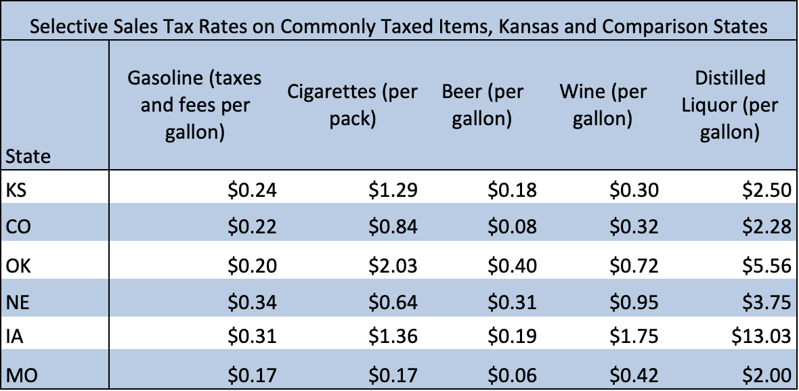
Selective Sales Tax Rates on Commonly Taxed Items, Kansas and Comparison States
Kansas ranks near the middle of our comparison states in selective sales tax rates.
Iowa is an outlier with a $13.03 a gallon liquor tax.
Data from the Tax Foundation

Slide 65
Liquor Tax Collection and Consumption
In 2009, liquor tax collections and alcohol consumption started to converge.
Suggests Kansans are now purchasing higher value products.

Slide 66
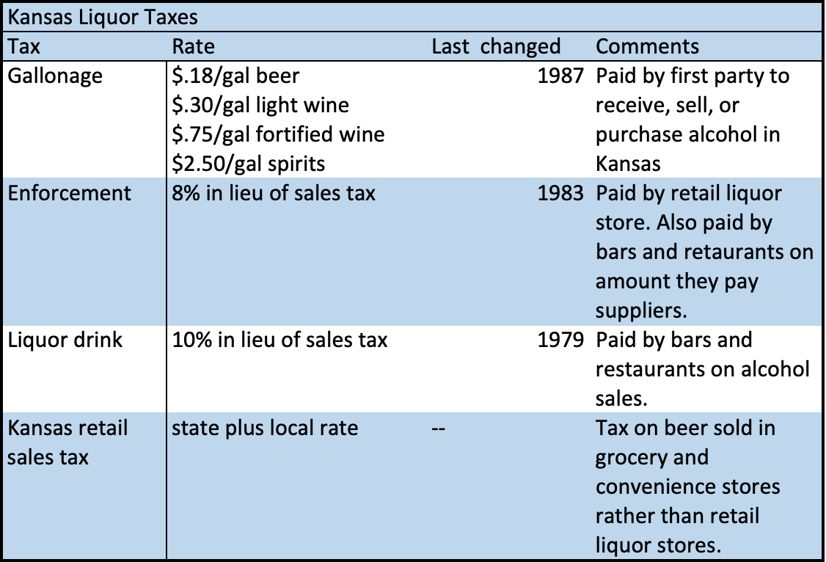
Kansas Liquor Tax Legislation
Kansas liquor taxes have not changed since 1987.
Retail sales tax on alcohol sales paid only on beer in grocery and convenience stores.

Slide 67
Per Capita Motor Fuel Tax Collections and Tax Rate
Per capita collections are falling.
Likely due to more fuel efficient vehicles.
Gallonage tax rate does not incorporate gas price changes.

Slide 68
Colorado Marijuana Tax Revenue
Includes a 15% (up from 10% in 2017) at the retail level, and various license taxes and fees.
2020 data are current through October.
10% of retail sales is distributed to local governments.

Slide 69
Kansas has not Legalized Marijuana
This month three states approved recreational marijuana
One state approved medical marijuana
Kansas is one of three states that has not legalized marijuana.

Slide 70
State and Local General vs. Selective Sales Tax Revenue
Kansas selective sales tax revenue is around a third of general sales tax revenue.
Similar proportion to all comparison states except Iowa, where selective sales tax revenue is around half.
2018 data from the Census Bureau Annual Surveys of state and local government finances

Slide 71
State vs. Local Selective Sales Tax Revenue
The vast majority of selective sales tax revenue is collected at the state level in Kansas and our comparison states.
  81% in Kansas
  82% in the entire US
  89% in Oklahoma
  74% in Missouri

Slide 72
US Shares of State and Local Selective Sales Tax Revenue
25% Motor fuel
4% Alcohol
10% Tobacco
14% Public utilities
48% Other
  Includes other fuels, lodging, marijuana, gambling and others.

Slide 73
Kansas Shares of State and Local Selective Sales Tax Revenue
31% Motor fuel
10% Alcohol
9% Tobacco
16% Public utilities
34% Other

Slide 74
Comparison State Shares of State and Local Selective Sales Tax Revenue (excluding CO)
35% Motor Fuel
3% Alcohol
11% Tobacco
14% Public utilities
36% Other

Slide 75
Colorado Shares of State and Local Selective Sales Tax Revenue
23% Motor fuel
2% Alcohol
7% Tobacco
5% Public utilities
64% Other
Marijuana Tax included in Other Selective Sales.

Slide 76
Selective Sales Tax as a Percentage of Total Tax Revenue
Kansas gets a smaller portion of our total tax revenue from selective sales taxes than the US average and all our comparison states except Nebraska.

Slide 77
Selective Sales Tax Revenue as a Percentage of Personal Income
Kansas selective sales tax revenue is lower as a percentage of income than Iowa and the US average.
Higher than Colorado, Missouri, Nebraska, and Oklahoma.

Slide 78
Per Capita Selective Sales Tax Revenue
Kansas per capita selective sales tax is lower than Colorado, Iowa and the US average.
Higher than Missouri, Nebraska, and Oklahoma.

Slide 79
Conclusions: COVID & Economy
COVID is out of control in the state
  It will take about a month before the mask mandate will be successful in bending the curve.
  It may take even longer because of the holidays
Kansas Economy
  Employment has not fully recovered
  Initial claims are increasing
  More small businesses are closing
  The economy needs additional support from the federal government

Slide 80
Conclusions
Sales Taxes
  Sales taxes are high in Kansas
  Local sales taxes push rates up over 10% in some counties
  Kansas is one of only three states that:
    Has no marketplace facilitator law
    Has no form of legalized marijuana
Business Sales Taxes
  Many exemptions
Excise Taxes
  Kansas has not changed taxes on
  alcohol in decades.

Slide 81
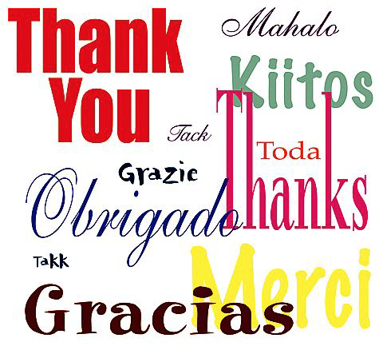
Thank You!
Danke

