Slide 1

Overview of Senate Bill 22 From 2019 Legislative Session
Governor’s Tax Council
October 15, 2019
Kathleen Smith and Michael Hale,
Kansas Department of Revenue

Slide 2
Senate Bill 22 Overview
SB 22 proposed several changes to the Kansas income tax provisions in response to changes in the Internal Revenue Code (IRC) enacted in late 2017;
SB 22 reduced the state sales tax rate by 1.0 percent on certain purchases of food; and,
SB 22 proposed a number of provisions in response to a U.S. Supreme Court decision authorizing states and local units to collect sales and compensating use taxes on certain transactions made through out-of-state retailers and marketplace facilitators that have an economic presence (nexus) in Kansas.

Slide 3
Individual Income Tax
SB 22 proposed to remove a restriction (or de-coupled from the IRC) preventing Kansas individual income taxpayers from itemizing deductions for state income tax purposes unless they also itemize deductions for federal income tax purposes.
Beginning with tax year 2018, SB 22 would have provided an option to take Kansas itemized deductions regardless of whether itemized deductions or the standard deduction are claimed for federal tax purposes.
The bill authorized the filing of amended returns through December 31, 2019, for purposes of this provision’s retroactive applicability to tax year 2018.

Slide 4
Business Income Tax
SB 22 proposed to de-couple Kansas statute from the IRC for tax year 2017 and thereafter. Kansas would not tax deferred foreign income, defined to include income under section §965(a) of the IRC certain repatriated income. SB 22 required certain deductions used in determining federal adjusted gross income for the repatriated income to be added back for Kansas income tax purposes prior to the determination of Kansas adjusted gross income.
SB 22 de-coupled Kansas statute from the IRC for tax year 2018 and thereafter, concerning global intangible low taxed income (GILTI) under section § 951A of the IRC. Said income would not be subject to the Kansas income tax under SB 22. The bill required certain related deductions claimed prior to the determination of federal adjusted gross income to be added back prior to the determination of Kansas adjusted gross income.

Slide 5
Business Income Tax cont’d
SB 22 would have exempted, for tax year 2018 and thereafter, certain disallowed business interest under § 163(j) of the IRC in effect on January 1, 2018, while deductions attributable to a carry-forward of such disallowed business income under the IRC in effect on that date were required to be added back for all years beginning with tax year 2018.
SB 22 further provided, for tax year 2018 and thereafter, certain capital contributions, as determined under the IRC § 118, to be excluded from the Kansas income tax.
Additionally, for tax year 2018 and thereafter, amounts attributable to the disallowance of Federal Deposit Insurance Corporation (FDIC) premiums paid by certain large financial institutions were to be excluded from Kansas income taxation under SB 22.

Slide 6
Sales Tax on Food
SB 22 proposed to reduce the sales tax rate on certain food and food ingredients from 6.5 percent to 5.5 percent beginning October 1, 2019. The reduction was to extend to substances sold for ingestion or chewing by humans and consumed for their taste or nutritional value and applied to items eligible to be purchased with food stamps issued by the U.S. Department of Agriculture.

Slide 7
Internet Sales and Use Tax
SB 22 proposed to enact the Kansas Main Street Parity Act (KMSPA), designed to clarify the applicability of Kansas sales and use tax provisions to certain out-of-state retailers and marketplace facilitators. Generally, such entities were to be required, beginning October 1, 2019, to collect tax if they have more than $100,000 in total gross sales sourced to Kansas.
SB 22 excluded from the definition of “marketplace facilitators” platforms and forums providing certain Internet advertising services and those entities selling or charging for rooms, lodging, or accommodations for occupancy provided by hotels, motels, or inns.

Slide 8
SB 22 Fiscal Effect Individual & Business Taxes
 |  |  | (Millions)
 |  | FY 2020 | FY 2021 |  | FY 2022
Itemized Deduction Option |  | ($50.1) | ($60.3) |  | ($60.9)
Repatriation |  | ($10.5) | ($0.4) |  | ($0.2)
GILTI |  | ($70.9) | ($24.7) |  | ($24.2)
Limitation on Interest Deductions |  | ($53.1) | ($25.5) |  | ($30.6)
FDIC Premium Deductions |  | ($2.7) | ($1.3) |  | ($1.3)

Slide 9
SB 22 Fiscal Effect Sales Tax Reduction on Food & Internet Sales
 |  |  | (Millions)
 |  | FY 2020 | FY 2021 |  | FY 2022
Sales tax Rate Reduction on Food
State General Fund |  | ($36.5) | ($55.4) |  | ($56.3)
State Highway Fund |  | ($7.0) | ($10.7) |  | ($10.8)
Internet Sales Tax
State General Fund |  | $18.2 | $27.7 |  | $28.2
State Highway Fund |  | $3.5 | $5.4 |  | $5.5

Slide 10
Total Fiscal Effect SB 22
 |  |  | (Millions)
 |  | FY 2020 | FY 2021 |  | FY 2022
Total |  | ($209.1) | ($145.2) |  | ($150.6)
State General Fund |  | ($205.6) | ($139.9) |  | ($145.3)
State Highway Fund |  | ($3.5) | ($5.3) |  | ($5.3)

Slide 11
Update on State Tax Conformity with the International Tax Provisions of the Tax Cuts and Jobs Act
Governor’s Tax Council
October 15, 2019
Michael Hale,
Kansas Department of Revenue

Slide 12
CORPORATE INCOME TAX 101
Three Basic Principles (and one corollary) That Act as The Foundation of Kansas Income Tax
Conformity with The Internal Revenue Code;
Combined Reporting;
Apportionment of Income; and
Subpart F Income – a corollary to income inclusion

Slide 13
Types of Conformity to the Internal Revenue Code
“Rolling” conformity automatically conforms to the latest version of the IRC. Kansas adopted rolling conformity in 1967.
“Fixed” or “static” IRC conformity calculates state taxable income as of a certain date.
“Selective” conformity adopts only certain provisions of the IRC, or certain provisions as of a certain date.

Slide 14
Kansas is a “Rolling Conformity” State

Slide 15
Methods of Filing State Income Taxes
How do states with an income tax require returns to be filed that fairly represents a corporation’s business activity in that state? There are two primary ways:
  Separate reporting, which allows companies to report the profit of each of its subsidiaries independently; and,
  Combined reporting, which requires a multi-state corporation to add together profits of all of its subsidiaries, regardless of their location, into one report.

Slide 16
Kansas is a Combined Report State
Kansas adopted the combined report method of reporting in 1967.
The primary goal of combined reporting is twofold:
Recognition that each part of a multistate business may be contributory to and dependent on the activities of other members of the business, and therefore those activities (income) should be taken into consideration when determining that state’s allocable share of income to be taxed by that state; and,
To create a level playing field for all businesses, by ensuring that large multistate corporations cannot end up paying income tax at a lower effective tax rate than small businesses by subdividing themselves into separate corporations and then manipulating transactions within the overall corporate group.

Slide 17
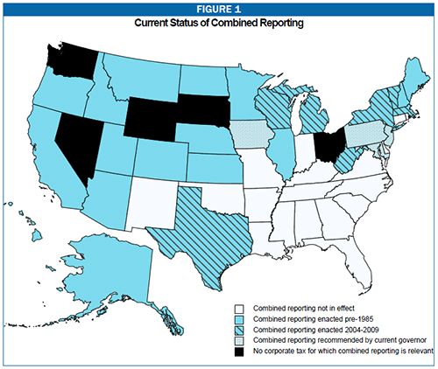
Combined Reporting at The Start

Slide 18
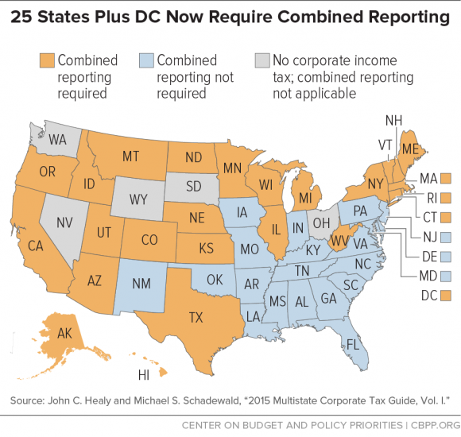
Combined Reporting by State

Slide 19
Combined Reporting is About Equity
Combined reporting is more equitable than separate reporting because:
It ensures that a company’s tax does not change merely because its organizational structure changes;
It creates a level playing field between smaller and larger companies;
It ensures that all business activities within a multistate business is accounted for when determining that state’s pro rata share of allocable income.

Slide 20
Apportionment of Income
Once all of a multistate business’ income has been combined, how does a state determine how much of that income is subject to its income tax? In one word: apportionment. The basic idea of apportionment is to attribute income of a unitary business to a particular state based on a ratio of the activity in that state compared to that business’ activity everywhere. There are two primary methods in use by states today:
Single factor based on sales that are within the state compared to the total sales everywhere; and,
Three factors based on sales (or receipts), payroll, and property that are within the state compared to the total sales, payroll and property that the corporation has everywhere.

Slide 21
Kansas Adopted The Three-Factor Formula
In 1963, Kansas adopted the three-factor apportionment formula to determine the income of a multistate business operating, more or less, in the same line of business. This is known as the unitary business principle.
The amount of a corporation’s payroll in Kansas is divided by the unitary group’s total payroll everywhere;
The value of corporation’s property in Kansas is divided by the value of the unitary group’s total property everywhere; and,
The corporation’s total sales in Kansas is divided by the total sales of the unitary group everywhere.
Each of these provide a fraction, which are then added together and divided by three to provide a final ratio that is then applied to the corporation’s Kansas taxable income.

Slide 22
Standard is Not Perfection,
But Fair Representation
In Container Corp. v Franchise Tax Board, 463 U.S. 159 (1983), a California case, the US Supreme Court approved, in general, the three-factor income apportionment formula.
The Court recognized that arriving at precise territorial allocation of "value" is often an elusive goal, both in theory and in practice.
The Court noted that not only has the three-factor formula met its approval, but it has become something of a benchmark against which other apportionment formulas are judged.
The Court, in upholding the three-factor formula, indicated that while formulary apportionment may not be precise, it is a fair reflection of a business’ activity in a state.

Slide 23
Why Bother To Apportion?
A simple illustration will show the genius of factor apportionment within the framework of combined reporting:
The following example will provide a simple calculation of ACME Corporation’s (ACME) 2017 income taxes without any apportionment. ACME has five corporations, one in Kansas, and the others are outside of Kansas. Each corporation provides one step in a series of integrated steps in the same line of business.

Slide 24
2017 Kansas Tax Without Apportionment
2017 Income from Five Corporations in the Unitary Group |  | $12,000,000
Kansas Tax Without Apportionment at 7% |  | $840,000

Slide 25
2017 Tax With Apportionment
 |  | Property |  | Payroll |  | Sales
Kansas Only |  | $2,300,000 |  | $900,000 |  | $15,000,000
Unitary Group |  | $280,000,000 |  | $283,000,000 |  | $12,000,000,000
KS Property factor |  | 0.00821
KS Payroll Factor |  | 0.00318
KS Sales Factor |  | 0.00125
Total KS Factor |  | 0.00421 |  | This is the percent that can be attributed to KS activity
Kansas Tax at 7% With Apportionment |  | $3,540 |  | ($12 million x .00421 x 7%)

Slide 26
Subpart F Income
Subpart F income is comprised of various income sources: royalties, license fees, etc., but most of it is comprised of dividend income.
Subpart F income typically is income that is relatively movable from one taxing jurisdiction to another and, for our discussion today, that is subject to low rates of foreign tax.
Subpart F income only applies to Controlled Foreign Corporations (CFC’s).
Approximately 18 states and the District of Columbia include at least some percentage of Subpart F income of a corporation’s total income in their state tax base. Kansas adopted its Subpart F statute in 1987

Slide 27
Kansas Taxation of Subpart F Income
Beginning in 1987, Kansas has taxed a portion of Subpart F income. Kansas statute allows an 80% subtraction of Subpart F income from a business’ Federal Taxable Income before it applies the apportionment factors and tax rates. In other words, Kansas is applying its apportionment factors and tax rates to only 20% of a business’ Subpart F income.
Why does this not violate the Foreign Commerce Clause? Combined reporting and apportionment.
The Supreme Court has recognized that combined reporting and apportionment of Subpart F income allows recognition of a foreign subsidiaries contribution to the total income of a business without unduly burdening foreign commerce. See footnote 23 of Kraft General Foods v. Iowa Dept. of Revenue, 505 U.S. 71 (1992).
The Kansas approach to Subpart F income has been specifically upheld as constitutional. See, In re Morton Thiokol, 254 Kan. 23 (1993).

Slide 28
Kansas Income Tax in the TCJA World
In late December 2017, congress passed the Tax Cuts and Jobs Act. It affected a number of federal statutes, and, as a rolling conformity state, those changes had an effect on Kansas Income Tax.
Six key provisions in the business-related provisions:
“Repatriation;”
Global Intangible Low-Taxed Income “GILTI;”
Expensing of Depreciable Assets and “Bonus” Depreciation;
Limitation on Interest Deduction;
Capital Contributions; and,
Deductions of FDIC Premiums.

Slide 29
§965 Repatriation of Foreign Funds
The Federal Act provides for a one-time tax at preferential rates on deemed repatriation of certain deferred income of US owned foreign companies. While the monies were to actually be brought into the US in 2018, all of the tax triggering events were to be determined in 2017.
§965 income is Subpart F income, and should be treated as such.
Because Kansas is a rolling conformity state that includes a portion of Subpart F income in its calculations, 20% of these “repatriated” dollars have been included in the Kansas base, apportioned, then taxed. Kansas is not alone in this treatment.

Slide 30
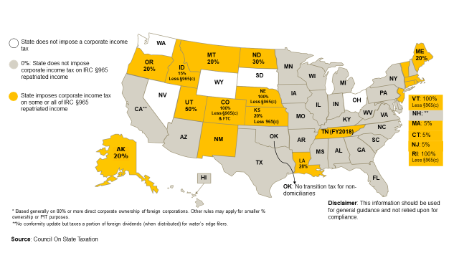
State Treatment of IRC §965 Repatriated Income

Slide 31
Kansas Tax with §965 Repatriated Income
2017 Income from Five Corporations in the Unitary Group Without Repatriation Dollars |  | $12,000,000 |  | Repatriated Dollars |  | $7,000,000
Kansas Subtractions |  |  |  |  |  | ($5,600,000)
Repatriated Dollars to be included in 2017 Income |  | $1,400,000
2017 Income from Five in the Unitary Group |  | $13,400,000

Slide 32
Kansas Tax with §965 Repatriated Income cont’d
 |  | Property |  | Payroll |  | Sales
Kansas Only |  | $2,300,000 |  | $900,000 |  | $15,000,000
Unitary Group |  | $280,000,000 |  | $283,000,000 |  | $12,001,400,000
KS Property factor |  | 0.00821
KS Payroll Factor |  | 0.00318
KS Sales Factor |  | 0.00125
Total KS Factor |  | 0.00421 |  | This is the percent that can be attributed to KS activity
Kansas Tax at 7% With Apportionment |  | $3,953 |  | ($13.4 million x .00421 x 7%)

Slide 33
IRC §965 Repatriated Income Observations
The clear majority of returns with §965 Repatriated Income were filed in 2018. Due to timing matters, there may be a few filed by the end of October 2019, but most have been filed.
Currently, Kansas is allowing the §965(c) deductions to be netted against the §965 income.
This particular provision in the IRC was a one-time deal. So, it will not be in effect for tax years 2019, 2020, 2021, etc.

Slide 34
Comparing Apples to Apples
You may hear, well this state did not tax repatriation dollars, and that state did not tax them. Remember Corporate Income Tax 101 and ask:
  Is that state rolling conformity?
  Is that state a combined report state?
  What is that state’s apportionment factors?
  Does that state include Subpart F income in their base?

Slide 35
§951A and 250 Global Intangible Low-Taxed Income
Global Intangible Low-Taxed Income, or “GILTI” is specifically characterized as not being Subpart F income. These dollars are ordinary income.
GILTI went into effect in Tax Year 2018 and will continue.
The starting point of state GILTI is generally all of the global income earned by a business’ foreign subsidiaries (after subtracting a 10 percent return on foreign fixed assets).
GILTI includes intangible property such as goodwill, going concern value, workforce in place, or any other item the value of which is not attributable to tangible property or the services of an individual.
§250 allows US Business to deduct 50 percent of their GILTI, which serves to reduce the federal tax rate on that income from 21 percent (the new federal corporate income tax rate) to 10.5 percent.
Finally, § 960, as amended, permits U.S. shareholders to claim a foreign tax credit equal to 80 percent of foreign taxes paid on GILTI, which eliminates any federal tax on GILTI if the average foreign tax rate on that income is at least 13.125 percent (because 80 percent of 13.125 percent equals the new U.S. tax rate of 10.5 percent).

Slide 36
Kansas Tax with GILTI Inclusion
2018 Income Five Corporations in the Unitary Group |  | $12,000,000
2018 GILTI Receipts |  | $2,000,000
2018 Total Income |  | $14,000,000

Slide 37
Kansas Tax with GILTI Inclusion cont’d
 |  | Property |  | Payroll |  | Sales
Kansas Only |  | $2,300,000 |  | $900,000 |  | $15,000,000
Unitary Group |  | $280,000,000 |  | $283,000,000 |  | $12,002,000,000
KS Property factor |  | 0.00821
KS Payroll Factor |  | 0.00318
KS Sales Factor |  | 0.00125
Total KS Factor |  | 0.00421 |  | This is the percent that can be attributed to KS activity
Kansas Tax at 7% With Apportionment |  | $4,130 |  | ($14 million x .00421 x 7%)

Slide 38
Kansas Tax Under The Various Examples
Tax Without Apportionment at 7% $840,000
KS Apportioned Tax at 7% $3,540
KS Apportioned Tax at 7% With Repatriated Dollars $3,953
KS Apportioned Tax at 7% With GILTI Dollars $4,130

Slide 39
Why The Need For GILTI?
One of the major motivations for the 2017 tax revision was concern about the international tax system, and specifically the loss of revenue due to the artificial shifting of profit out of the United States by multinational firms.
The number and complexity of these schemes, and the complexity of global business generally, overwhelm any tax department response.
Traditional tax enforcement methods are entirely inadequate to address this problem.
Congress noted a structural change to the system of taxing global enterprises was called for, and various components of the TCJA are Congress’s effort to deliver such a change.

Slide 40
State Relationship to Concerns Prompting GILTI
The facts that motivated Congress to act apply equally to the states.
Income shifting costs states billions of dollars each year, it contributes to an unfair tax system because only sophisticated global enterprises can engage in such activity, and most importantly — as Congress concluded — some income reported by foreign entities is income of U.S. corporations.
By incorporating GILTI into their tax code, states therefore would simply be following the federal government’s lead.
Adopting GILTI also promises to reduce, if not end, perpetual battles between tax authorities and taxpayers over where income should be sourced, a particular benefit to states if the IRS elects to curtail its enforcement efforts in this area in the wake of GILTI and in response to declining resources.

Slide 41
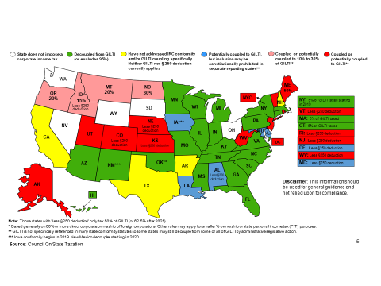
Current State Treatment of GILTI

Slide 42
Expensing of Depreciable Assets Under §179
TCJA increases the amount that a taxpayer may expense under §179 from $500,000 to $1,000,000, and increases the phase-out threshold to $2,500,000.
TCJA expands the definition of qualified real property to include all qualified improvement property and certain improvements made to nonresidential real property.
Because these federal adjustments will decrease federal taxable income, there will be a decrease in Kansas corporate tax collections. This is because the federal adjustments will decrease federal taxable income, the first line used in computing Kansas corporate income tax liability.
Kansas assets that qualify for the §179 depreciation deduction will also qualify for the Kansas expensing deduction. This means that an increase in the amount to be expensed on the federal return will result in an increased amount on the Kansas expensing deduction. With a higher Kansas expensing deduction, Kansas corporate income tax collections will decrease.

Slide 43
Bonus Depreciation
TCJA increases “bonus” depreciation to 100% from 50% for property placed in service between 9/27/2017-12/31/2022. Beginning in 2023 is a five-year phase down from 100% to 0% after 2026 at 20% per year.
Because these federal adjustments will decrease federal taxable income, there will be a decrease in Kansas corporate tax collections. This is because the federal adjustments will decrease federal taxable income, the first line used in computing Kansas corporate income tax liability.

Slide 44
Limitation on Interest Deduction
The Act limits the deduction for net interest expenses incurred by a business and cannot exceed the sum of business interest income, 30% of the business’s adjusted taxable income, and floor plan financing interest expense.
Businesses with average annual gross receipts of $25,000,000 or less are exempt from the limit. Disallowed interest could be carried forward indefinitely.
Allows real property trades or business that use the ADS and farming businesses to elect not to be subject to the business interest deduction limitation. Electing farming businesses must use ADS to depreciate property with a recovery period of 10 years or more. The interest deduction limit does not apply to certain regulated public utilities or to certain electric cooperatives. Applies to taxable years beginning after December 31, 2017.
Because Kansas begins its calculations of individual income tax liability with federal adjusted gross income, the limitation on deduction for interest will result in higher federal adjusted gross income, and therefore, higher Kansas individual income tax collections.

Slide 45
Capital Contributions
Prior to the TCJA, capital contributions by a government entity to a corporation were generally excluded from the definition of gross income.
The Act amended §118 to provide that contributions made by a government entity or civic group cannot be excluded as “contributions to capital.”
SB 22 would have allowed corporations to continue to exclude capital contributions by a governmental entity.

Slide 46
Limitation on Deduction for FDIC Premiums
Effective for tax years beginning after December 31, 2017, institutions with consolidated assets over $10 billion, are limited on the amount of FDIC premium payments that may be deducted. The limitation is a percentage derived from the ratio of excess consolidated assets over $10 billion to $40 billion.
Institutions with consolidated assets over $50 billion cannot deduct FDIC premium payments.
Limitation on deduction for FDIC premiums will result in higher federal taxable income, and, since Kansas begins its calculations with federal taxable income, higher Kansas corporate tax collections may be expected.
This would have a similar result for Kansas privilege tax collections.

Slide 47
Credits and Citations
Pages 1-8 Kansas Legislative Research
Page 17 Michael Mazerov, Center on Budget and Policy Priorities
Page 18 John C. Healy and Michael Schadewald, Center on Budget
and Policy Priorities
Page 19 Michael Mazerov, Center on Budget and Policy Priorities
Page 30 Council on State Taxation
Pages 39-40 Brian Hamer, Multistate Tax Commission
Page 41 Council on State Taxation

