Slide 1
Charting a Course for Tax Reform in Kansas
For Presentation at:
Governor’s Council on Tax Reform
Donna K. Ginther
Professor, Department of Economics
Interim Director, Institute for Policy & Social Research
Research Associate, National Bureau of Economic Research

Slide 2
Overview
Introduction to me and my work, the Institute for Policy & Social Research, and the research team
The Kansas Economic Context—Kansas faces significant headwinds
Review of the academic literature on taxation and state economic growth
Review of the academic literature on the Kansas Tax Experiment
A roadmap for the study of Kansas Tax Reform

Slide 3
Introduction
Dean’s Professor of Economics, University of Kansas & Interim Director of the Institute for Policy & Social Research.
Specialize in labor economics, economic demography and the economics of science.
Research Associate, National Bureau of Economic Research.
Previously employed as regional policy economist at the Federal Reserve Bank of Atlanta.

Slide 4
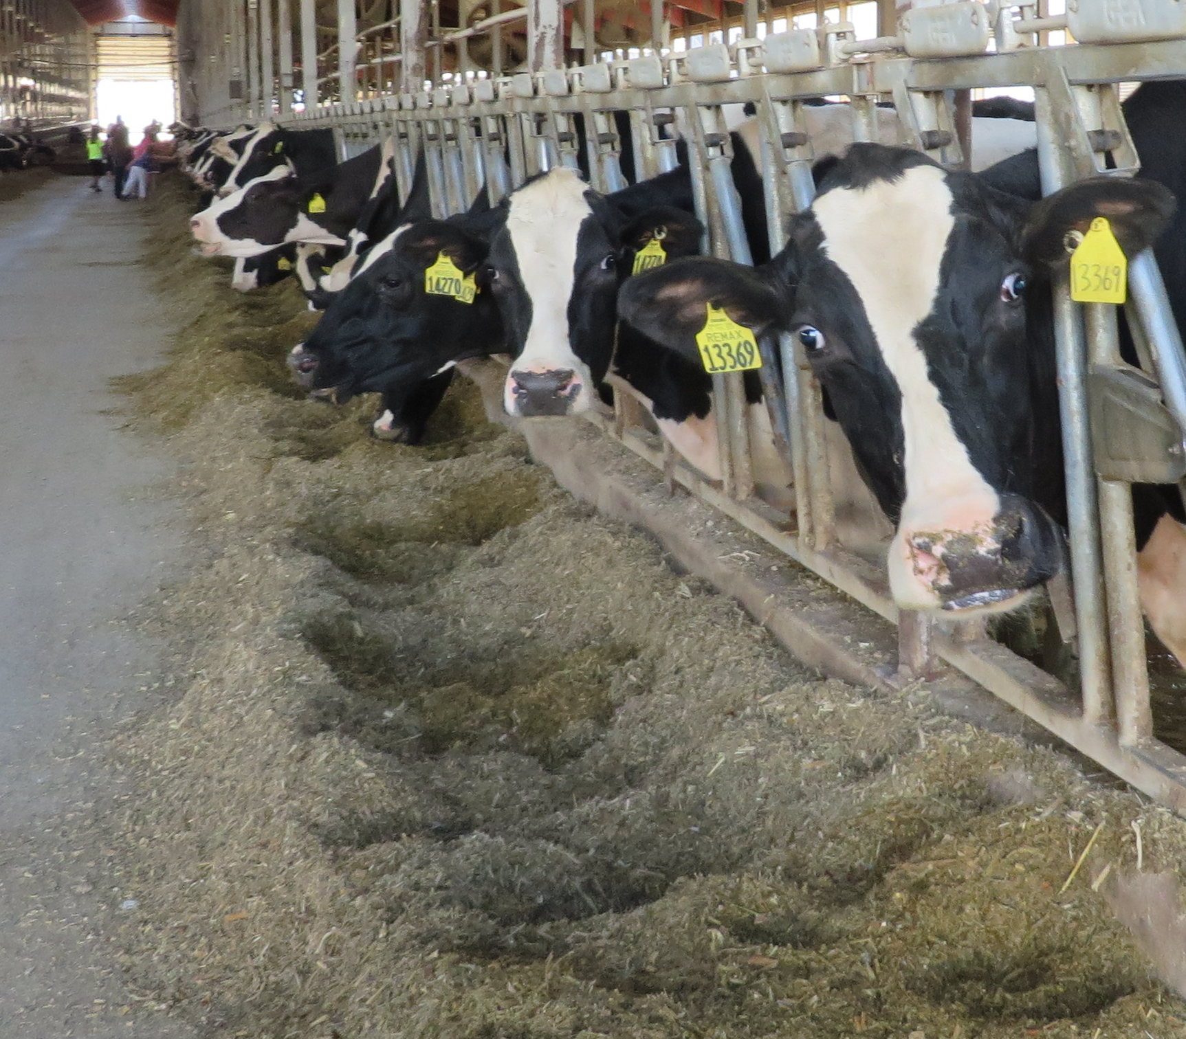
Rural, Midwestern Credentials
BA, MS & PhD in Economics from the University of Wisconsin-Madison

Slide 6
Institute for Policy & Social Research Mission
Facilitate and support fundamental, cross-disciplinary research on social problems and issues.
Foster and support the scholarly community for policy and social sciences at KU.
Provide policy-relevant research to Kansas state and local government as well as the federal government.
IPSR is the intellectual home for federally funded social science research at KU.
IPSR currently has 47 extant projects worth $7.9 million.

Slide 7
Institute for Policy & Social Research Mission
IPSR assists faculty with research development, administers sponsored research projects and provides research and data services.
IPSR was recently named the Kansas State Data Center by the US Census Bureau.

Slide 8
Center for Science, Technology & Economic Policy
CSTEP research focuses on science policy, scientific labor markets, education policy, and state and local economic development.
Contract Evaluations
Kauffman Foundation—Immigration in the Bi-State Region
Women’s Foundation of Greater Kansas City—The Status of Women in Kansas

Slide 9
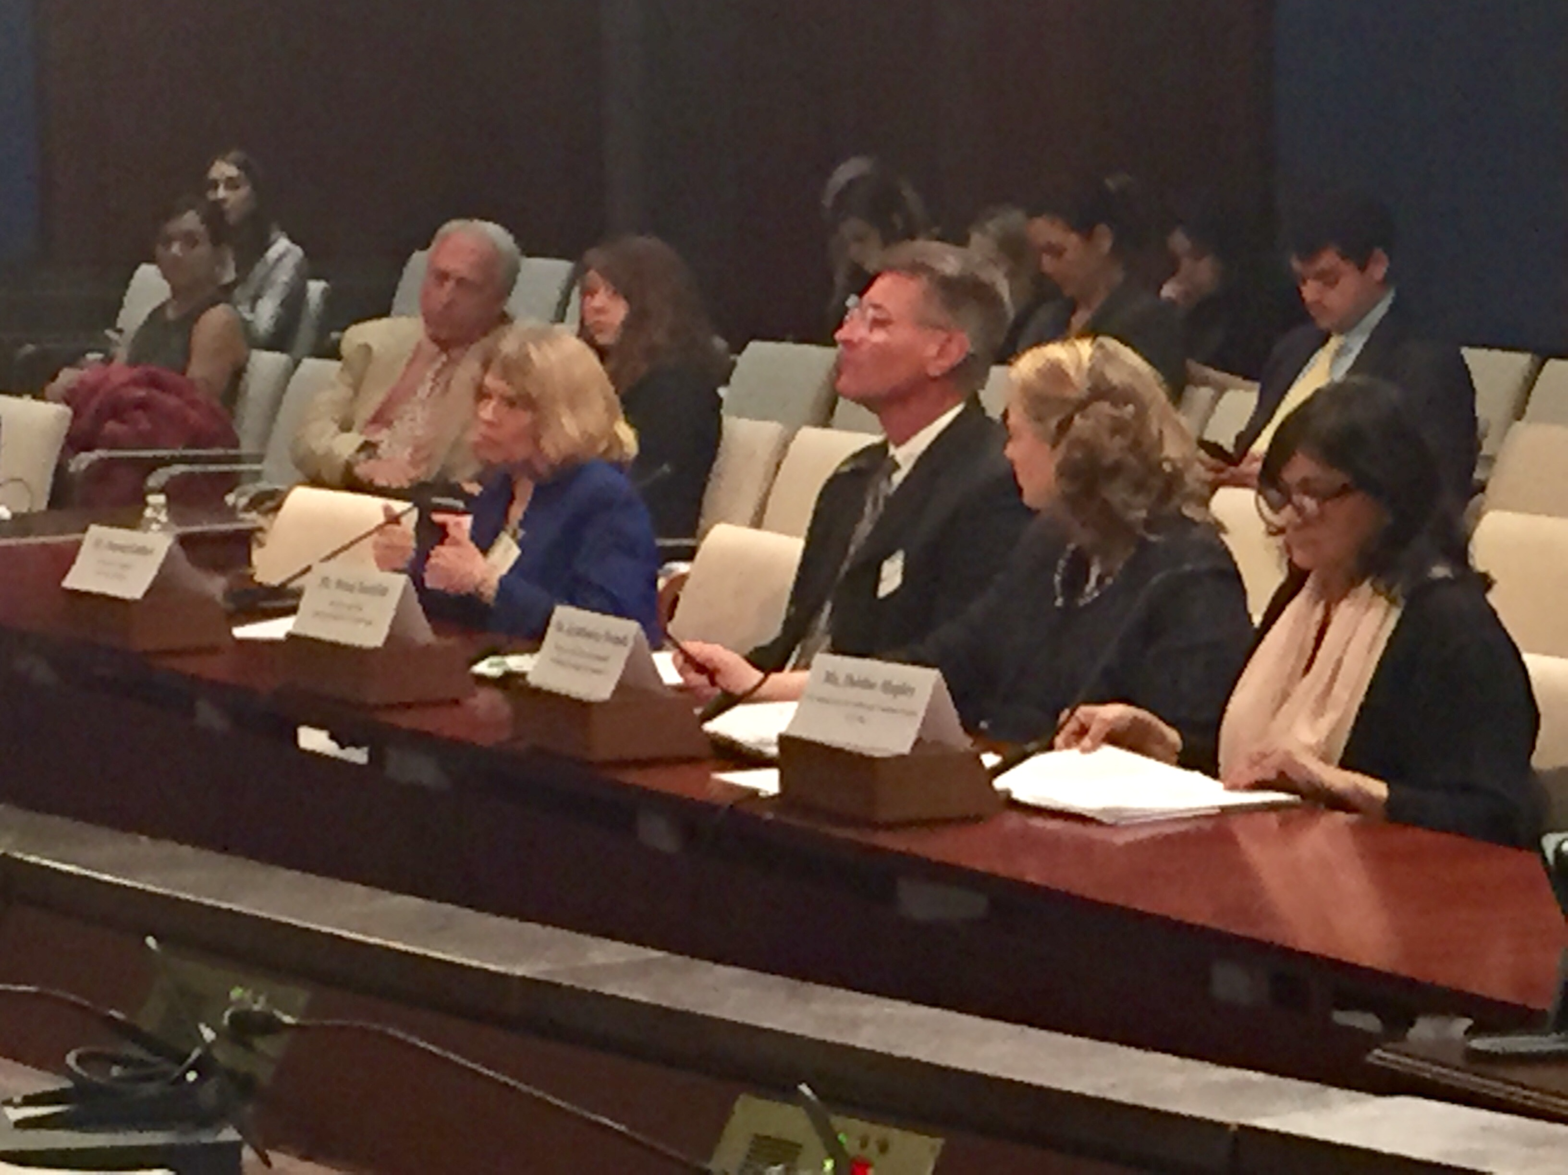
IPSR Contract Research
Testimony before US House of Representatives Working Group on Women in the 21st Century
Workforce, March 2017

Slide 10
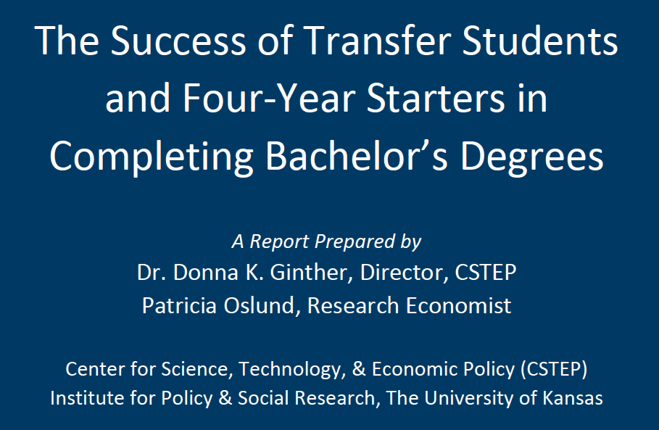
Kansas Board of Regents
Unlike previous studies from other states, we found that Kansas transfer students are significantly less likely to complete a bachelor’s degree. However, transfer students were more likely to be employed in the state

Slide 12
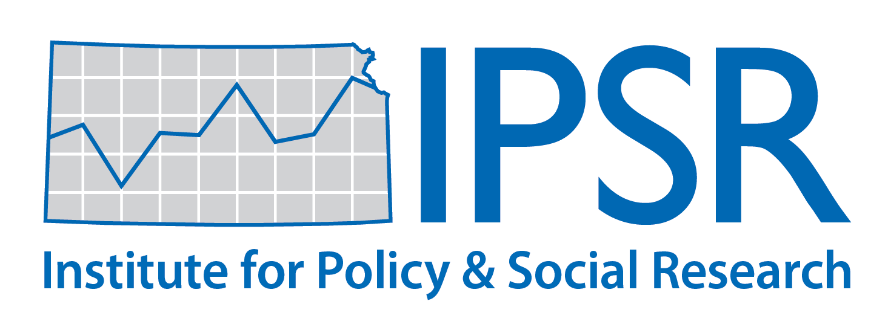
2018 Kansas Economic Policy Conference
Pragmatic Policy: Reforming Kansas Taxes
presented by
Institute for Policy & Social Research, The University of Kansas
live webcast sponsored by
KU Information Technology and Office of the Provost
Join the conversation on Twitter #kepc2018

Slide 13
Future of Work Conference—October 17th
Future of Work-–October 17, 2019, 9 AM – 5 PM
Register at: research.ku.edu/rsvp-futureofwork
Human Technology Partnerships
Lifelong Learning

Slide 14
Kansas Economic Policy Conference October 24th
What Counts for Economic Development in Kansas?
October 24, 2019, 8 AM – 3 PM
Register at: https://ipsr.ku.edu/conferen/kepc19

Slide 15
New Research Agenda: How Do State Tax Cuts Affect the Provision of Public Goods?

Slide 16
How Do State Income Tax Cuts Affect Public Goods?
Preliminary Work that examines the effect of state tax cuts on expenditures and outcomes
Natural Experiment: During the Great Recession, 18 states cut income taxes
These are the “treatment” states
Remaining states are the control group
We compare outcomes for treatment and controls to identify the causal effect of income tax cuts.
Work inspired by Kansas Tax Experiment.

Slide 17
How Do State Income Tax Cuts Affect Public Goods?
Preliminary Findings:
Sifat Adiya: Did Individual Income Tax Cuts Lead to More Deaths on the Highways? State level analysis using evidence from the Great Recession
Short Answer: Yes
Chloe Smith: Did Income Tax Cuts Affect Deaths of Despair?
Short Answer: Suicides increased
Noah Colby-George: Did Tax Cuts Affect High Skilled Migration?

Slide 18
State Disinvestments in Higher Education—Joint Work with Joshua Rosenbloom, Iowa State Univ.
National Science Foundation Grant 2019-2021
The Great Recession forced many states to cut funding for higher education.
In addition, 18 states cut income taxes to spur economic growth.
State tax cuts do not pay for themselves and often led to budget cuts to higher education.
Our research will examine what happens to the quality of faculty as measured by publications, citations and federal funding after state cuts to higher education institutions.

Slide 19
University of Kansas Experience
Of the top 70 funded researchers at KU 2014-2018,
10 (14%) were hired away with a loss of total revenue of $41.1 million
14 (20%) have or will retire with a loss of total revenue of $56.1 million
Those researchers left the university with $97.2 million.
We posit that state cuts to higher education creates adverse selection among the “star” scientists at public research universities.

Slide 20
Research Team

Slide 21
Tami Gurley-Calvez—Associate Professor, KU Medical Center
Studies Taxation, Health Economics, Entrepreneurship, and Medicaid
A member of the Board of Directors of the National Tax Association.
Researches the effect of taxation on entrepreneurship.
Author of over 15 papers and reports on tax issues.

Slide 22
Pat Oslund—Associate Researcher IPSR
Research on Kansas and national economic policy issues (education, immigration, taxation, economic impact analysis, benefit-cost analysis of state and local programs).
Coauthor of over 16 publications and reports on the Kansas Tax Climate including: “Kansas Tax and Business Climate Report” for Kansas, Inc. (2010)

Slide 23
The Kansas Economy

Slide 24
The Kansas Economy
Tax policy cannot be made in a vacuum. We need to understand the challenges that the state economy is facing.
Present recent analysis from the Federal Reserve Bank of Kansas City’s Kansas Economic Data Outlook.
Additional information is part of the Kansas Statistical Abstract
http://ipsr.ku.edu/ksdata/ksah/

Slide 25
Headwinds Facing the Kansas Economy
The Kansas Economy faces significant challenges moving forward:
Demography
Labor Force
Federal Policy
Macroeconomic
A Decade of State Disinvestment

Slide 26
Demography: Population Trends
United States
Kansas
Increased immigration
4.7% in 1970
13.4% in 2018
Changes in racial composition – white, not Hispanic
83.5% in 1970
60.4% in 2018
Increased immigration
1.2% in 1970
7.0% in 2018
Changes in racial composition – white, not Hispanic
92.3% in 1970
75.7% in 2018
Notes:
Edited racial composition to white, not Hispanic. Immigration in this slide refers to the foreign-born population.
Source: U.S. Census Bureau, 1970 Census, 2014 American Community Survey

Slide 27
Maximum Population by Year
Notes:
Source: Kansas Statistical Abstract; data from U.S. Census Bureau, Decennial Census.

Slide 28
Population Trends—Plains States
Notes:
Source: U.S. Census Bureau, 2014 Population Estimates, Components of Change

Slide 29
Headwinds: Labor Force
The Federal Reserve Bank of Kansas City’s Analysis of the Kansas
Labor Force shows that payroll employment in Kansas has grown
at half the rate of the US. The growth in the number employed has
Stagnated for a decade.
Source: The Kansas Data Book, Federal Reserve Bank of Kansas
City.
Notes:
Source: U.S. Census Bureau, 2014 Population Estimates, Components of Change

Slide 30
Headwinds: Labor Force
Kansas
10th District: KS, CO, MO, OK, WY
NE, NM
The Kansas Labor Force (Employed + Unemployed) has shrunk in the past decade.
This has not happened in the 10th District. Source: Federal Reserve Bank of Kansas City
Notes:
Source: U.S. Census Bureau, 2014 Population Estimates, Components of Change

Slide 31
Headwinds—Federal Policy
Federal Policy has hurt the Kansas Economy:
Immigration
Trade
US Macroeconomic Growth is slowing
Trade war impact?
Fed is cutting interest rates

Slide 32
Trump Administration Crackdown on Immigration
Source: LA Times, April 2017
Notes:
Source: Kansas Statistical Abstract; data from U.S. Census Bureau, Decennial Census.

Slide 33
Percentage of Immigrants by County in Kansas
Notes:
Source: Kansas Statistical Abstract; data from U.S. Census Bureau, Decennial Census.

Slide 34
Kansas Immigration Facts
Economic Impact of Immigrants in Kansas and the Bi-State Region available online at:
http://ipsr.ku.edu/publicat/ImmigrationKC2014.pdf
A much higher percentage of immigrants live in non-metro counties in Kansas compared to the US (28% vs. 4%)
About 2.6% of the Kansas population are undocumented immigrants
No negative effect of immigrants on wages in Midwestern metropolitan areas
Population growth leads to economic growth
Notes:
Source: Kansas Statistical Abstract; data from U.S. Census Bureau, Decennial Census.

Slide 35
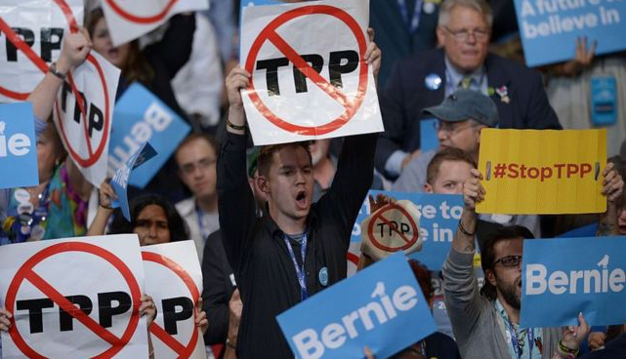
Trade Policy
Trump Administration:
--Ended involvement in Trans
Pacific Partnership
-- Renegotiate NAFTA
Photo Source: Getty Images
Manufacturing is the second largest sector in the Kansas economy (~13% of GSP)
Agriculture is the eighth largest sector (~6% of GSP)
Kansas exports were 7% of state GSP in 2018
Notes:
Source: Kansas Statistical Abstract; data from U.S. Census Bureau, Decennial Census.

Slide 36
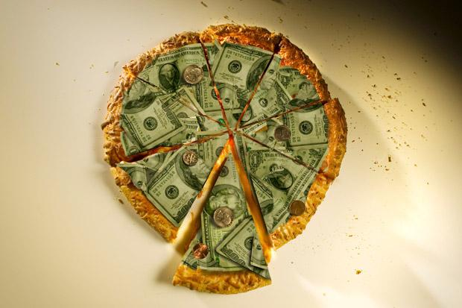
Economics of Trade
Trade increases the size of the economic pie.
Countries/states produce based on comparative advantage.
Ideal economic policy would retrain/compensate workers dislocated by trade.
Notes:
Source: Kansas Statistical Abstract; data from U.S. Census Bureau, Decennial Census.

Slide 37
Trade and the Kansas Economy
Kansas Top Trading Partners are:
Mexico---($1.9 bil)
Canada---($2.5 bil)
Japan---($0.9 bil)
China—($0.7 bil)
Germany—($0.4 bil)
Kansas Exported $11.6 billion in goods in 2018
Aircraft ($2.7 billion)
Beef ($2.5 billion)
Grains ($1.4 billion)
Notes:
Source: Kansas Statistical Abstract; data from U.S. Census Bureau, Decennial Census.

Slide 38
Free Trade and Kansas
Source: US Department of Commerce International Trade Administration
Free trade benefits the Kansas Economy
Notes:
Source: Kansas Statistical Abstract; data from U.S. Census Bureau, Decennial Census.

Slide 39
Free Trade and Kansas
A Farmer’s Tough Year on the Trade War’s Kansas Front
From planning to harvest, the grain belt’s rhythms and prospects have been disrupted by the government’s tariff battle with China.
Source: New York Times , November 29, 2018
From the US Trade Representative:
In 2018, Kansas goods exports were $11.6 billion, a decrease of 7 percent ($910 million) from its export level in 2008.
As of 2016 supports 60,000 jobs
Notes:
Source: Kansas Statistical Abstract; data from U.S. Census Bureau, Decennial Census.

Slide 40
Macroeconomic Uncertainty
Inverted Yield Curve may signal the start of a recession.
Trade war is disrupting global supply chains.
Federal Reserve cut interest rates.
Growth remains positive, but uncertainty and market volatility have increased.

Slide 41
Kansas Economy Summary
Kansas needs workers.
Slow population growth, aging population, and shrinking labor force translate into a smaller income and sales tax base.
Policies that restrict immigration and failure to reform immigration limit the state’s opportunity to attract prime-aged workers.
Trade policy harms agriculture and manufacturing in the state.
Macroeconomic uncertainty prevails.

Slide 42
Academic Research on: Tax Cuts & Economic Activity The Kansas Tax Experiment

Slide 43
Academic Research Tax Cuts & Economic Activity
Tax cuts are not self-financing (e.g. Soldatos 2015, Gale, Gelfond et al. 2018)
Tax cuts have mixed effects on economic growth (Reed 2009, Lee and Gordon 2005, Conway and Rork 2008)
Tax cuts affect revenue reporting, but not necessarily real business activity (Bruce 2002, Gentry and Hubbard 2000, Gurley-Calvez and Bruce 2008)
Businesses prefer tax code simplicity and predictability (Saade and Johnson, 2005)

Slide 44
Brownback Tax Cuts Were a Natural Experiment
Sam Brownback June 2012: "On taxes, you need to get your overall rates down, and you need to get your social manipulation out of it, in my estimation, to create growth. We'll see how it works. We'll have a real live experiment.”
Economists use policy changes (like the Brownback tax cuts) to identify the causal effects of policy on outcomes by comparing treatment (states that change policies) to controls (states that stay with the status quo).

Slide 45
Impact of State Tax Cuts on Pass-Through Business
DeBacker, Heim, Ramnath & Ross (2019) “The impact of state taxes on pass-through businesses: Evidence from the 2012 Kansas income tax reform” Journal of Public Economics
In theory, the pass-through exclusion would incentivize businesses to expand or form new companies.
Use federal income tax data to examine what happened in Kansas.

Slide 46
Impact of State Tax Cuts on Pass-Through Business
Personal income Tax Revenue Growth (2007=100) Source: DeBacker, Heim, Ramnath & Ross (2019);

Slide 47
Impact of State Tax Cuts on Pass-Through Business
Found that the increase in reported self-employment was driven by “recharacterization of income” not real economic activity.
Estimate this accounts for $8.6 million in lost tax revenue.
Among existing sole proprietorships, income shifted from wages to pass-through income.
Conclude that in practice Kansas tax cuts generated tax avoidance.

Slide 48
Effects of Tax Cuts on Employment Growth
Turner & Blagg (2018) “The Short Term Effects of the Kansas Income Tax Cuts on Employment Growth” Public Finance Review.
Compare Kansas to border states in terms of employment growth 2012-2014
“ We observe neither an increase in the number of jobs at establishments nor an increase in the number of proprietors in Kansas relative to the outcomes in neighboring states, which did not experience a tax law change.”

Slide 49
Kansas Tax Experiment—Synthetic Control
McCloskey (2018) “The Kansas Tax Experiment: Impact of 2012 Tax Reform on Output, Employment & Establishments”
Synthetic Control Method
Kansas is Treated State (Tax Cuts)
Other states make up a weighted average of “synthetic Kansas”
Border states + Idaho, Iowa, Arkansas, Mississippi, Georgia, South Carolina, West Virginia, Pennsylvania, Massachusetts, Maine

Slide 50
Kansas Tax Experiment—Tax Revenues
Source: McCloskey (2018)

Slide 51
Kansas Tax Experiment—Synthetic Control Real Gross State Product
Source: McCloskey (2018)

Slide 52
Kansas Tax Experiment—Synthetic Control Total Employment
Source: McCloskey (2018)

Slide 53
Effects of Kansas’ Tax Reform—Synthetic Control
Hayes (2017) “Effect of Kansas’ Tax Reform of 2012: Evidence from a Synthetic Control Method”
“The current study also finds that there was no increase in state GDP per capita or any decrease in the state annual unemployment rate. This suggests that Kansas’ tax cuts did not increase economic outcomes in the state, but instead resulted in a significantly large opportunity cost for the state in the form of forgone revenues that could have been used for alternative government programs.”

Slide 54
Summary Kansas Tax Experiment
Taxpayers responded to the pass-through exemption by reclassifying income and engaging in tax avoidance.
The state general fund and public services suffered.
No discernable impact on employment or economic growth from the tax cuts relative to “control” states or a “synthetic” Kansas.

Slide 55
Charting a Course on Tax Reform

Slide 56
Tax Reform: Big Picture
Tax Reform is hard!
The Council has its work cut out for it.
Pick low-lying fruit to build consensus and then tackle the most difficult problems:
Rank order potential policies by degree of difficulty
Responding to the Wayfair decision without other tax policies would be a good first step.
Identify best practices from other states: How can we make this process work for Kansas?

Slide 57
Research: Kansas Tax Policies
Start by identifying how much revenue the state needs to collect.
How can we collect taxes in the least distortionary manner?
How can we address the equity (or lack thereof) in our tax policy?
Use expenditures for policy priorities.

Slide 58
Research: Tax Incidence
Any proposed tax policy needs to address two questions:
How much will this tax policy cost?
Who will pay more or less as a result?
The consensus revenue forecasting committee did a good job of answering question (1) during the Brownback Administration.

Slide 59
Research: Kansas Tax Policies
State taxes do not occur in a vacuum. We need to compare Kansas tax policies to border states:
Iowa, Missouri, Oklahoma, Colorado, Nebraska
This comparison should include discussion of:
Tax Mix, Demographics, Economy
,

Slide 60
Research: Tax Incidence
Models of state tax incidence are more complicated than federal tax incidence.
Very few states have a full distributional analysis of their tax system.
A fully developed tax incidence model would take a lot of time and money to create (few models available).

Slide 61
Research: Tax Incidence
We Propose: developing a set of hypothetical taxpayers representing the demographics of the states to analyze tax policy changes. We will measure:
Total taxes paid
Progressivity & Regressivity
Implications for the three-legged stool

Slide 62
Research: Tax Incidence Will Provide
Comprehensive picture of distribution of state/local taxes
Interpretable results
Testing of distributional impact of taxes
Be robust to assumptions and incorporate economic best practices
Be based on reliable data

Slide 63
Let’s Get Started: Sales Taxes!
IPSR did some cursory analysis of the wide variety of sales taxes across the state.
In Kansas there are 65 different sales taxes depending on location.
In the Legends, there are a wide variety of sales taxes depending on the store.
Johnson County has 17 different sales tax rates across the 75 sales tax areas in the county.

Slide 64
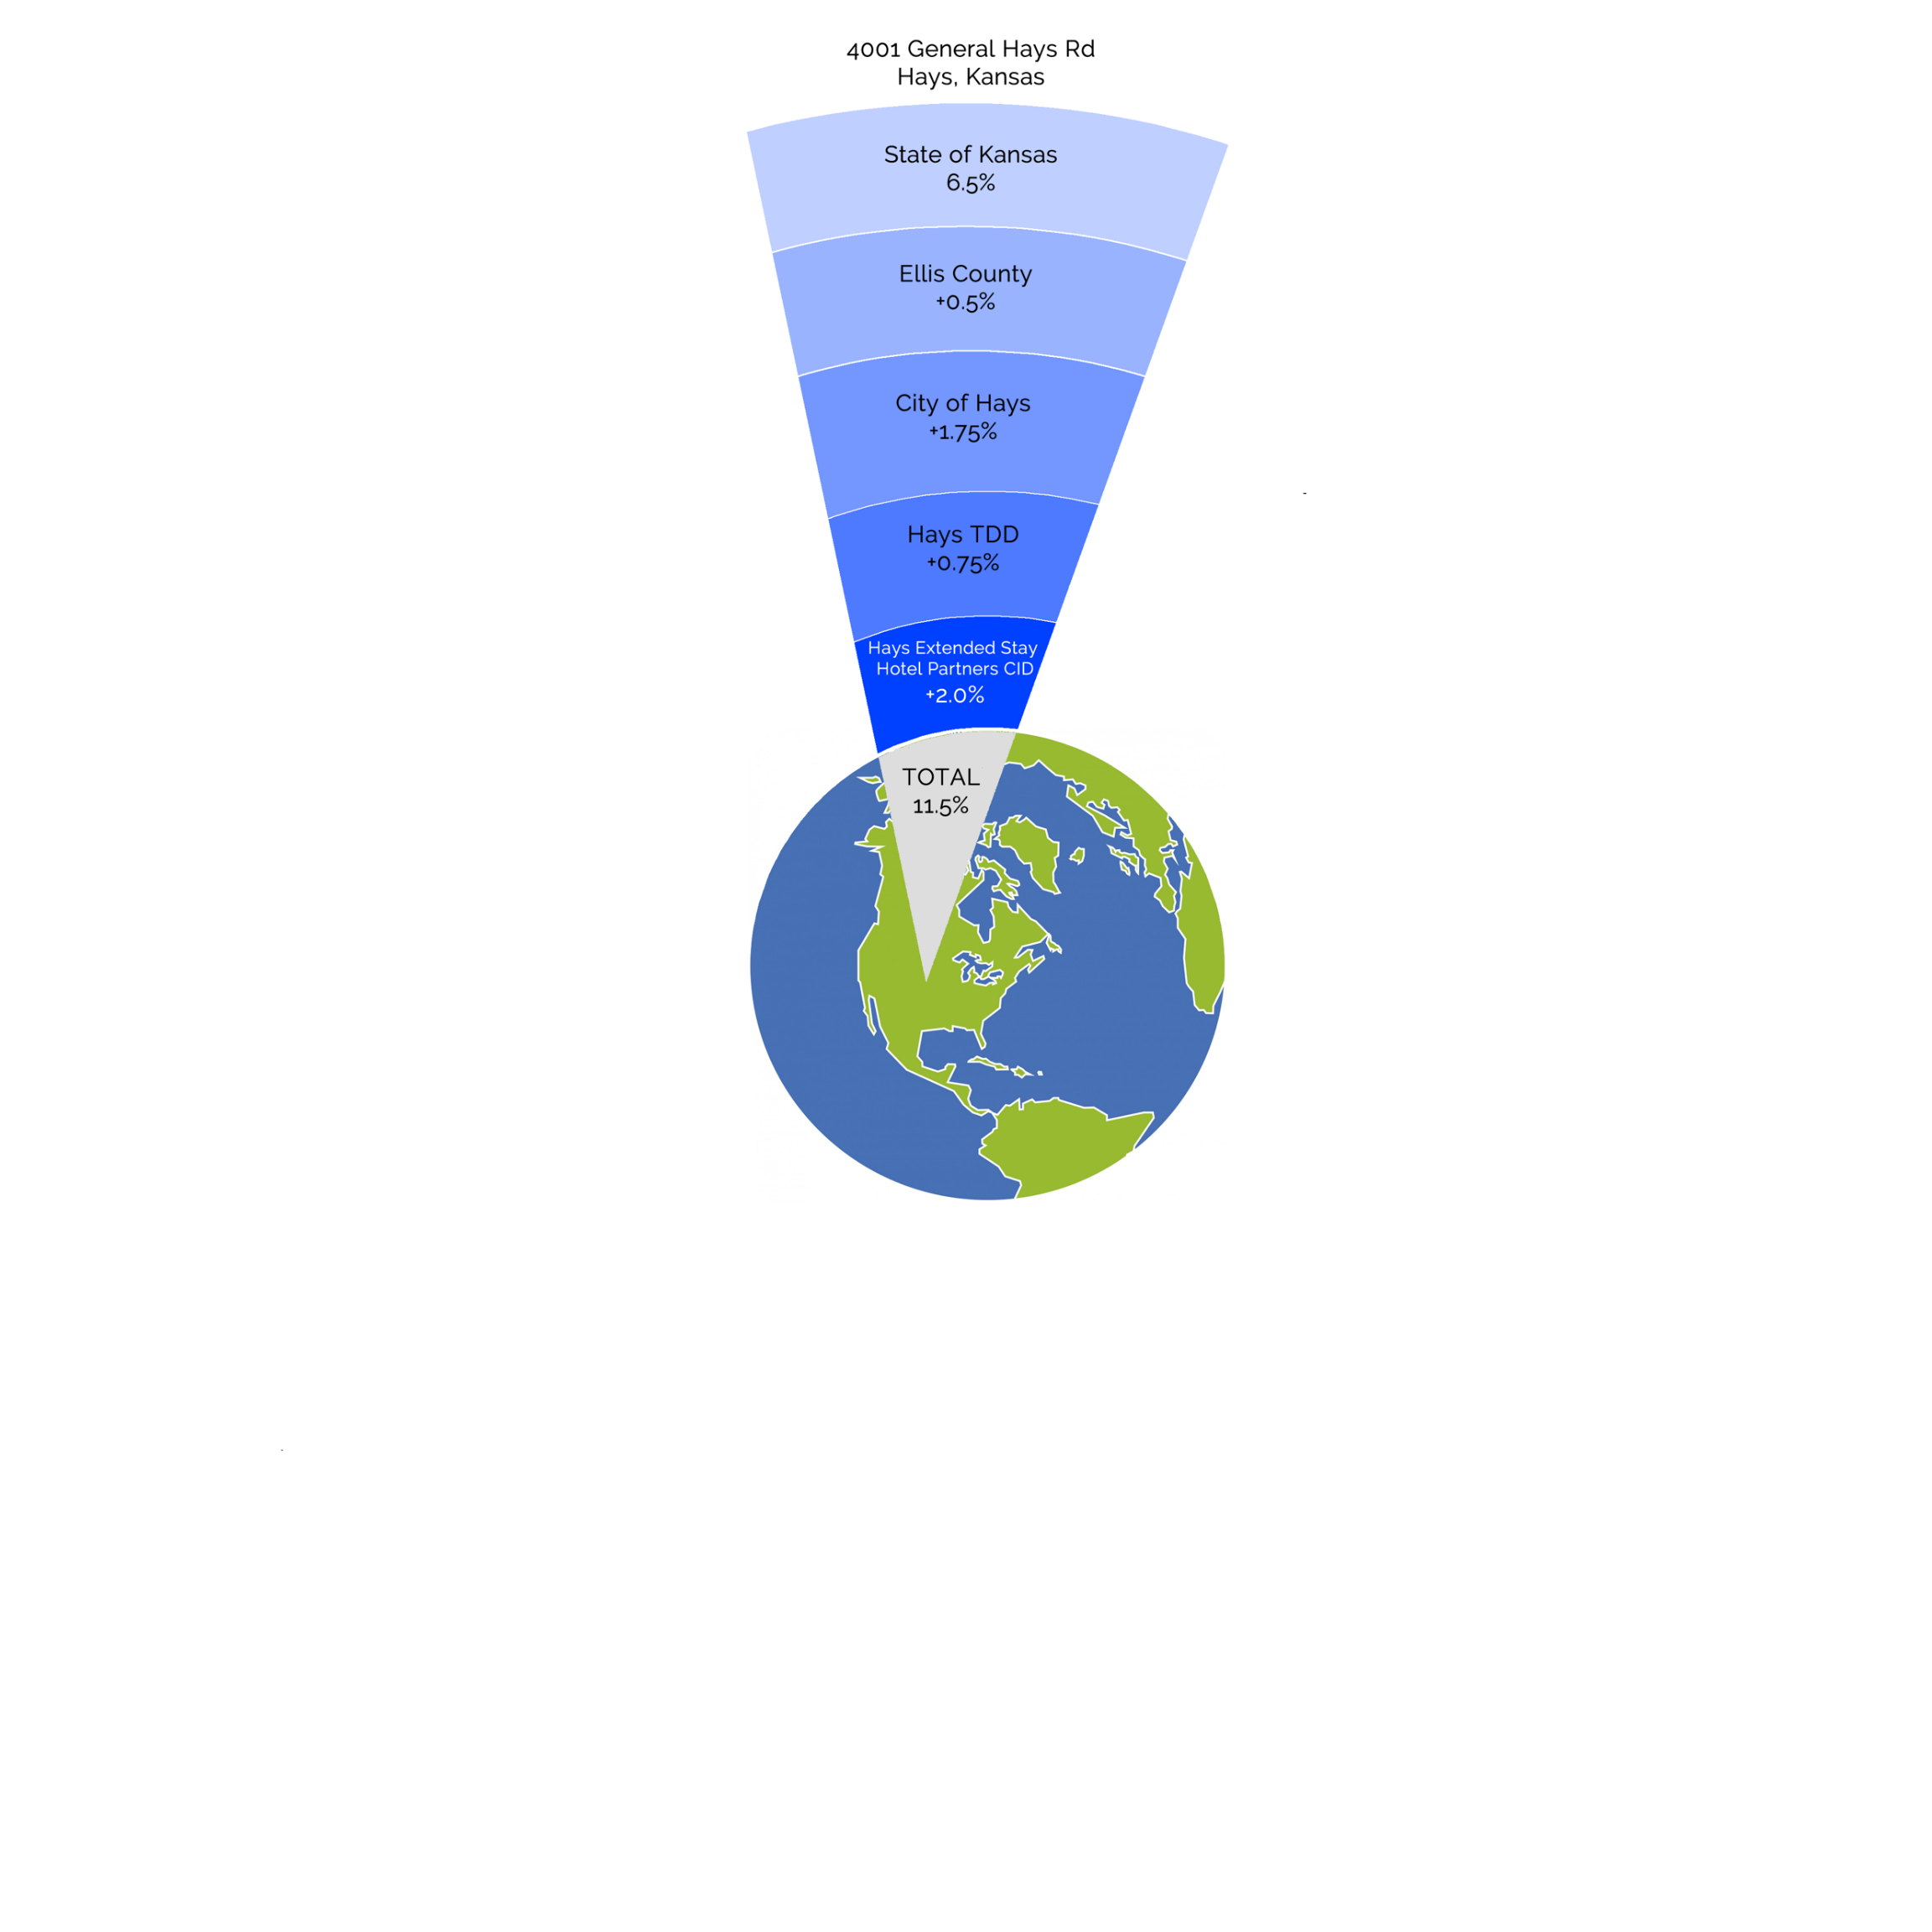
At one location in
Hays, Kansas there
are 5 different sales
taxes for a single purchase
that lead to a tax rate of
11.5%.

Slide 65
In Kansas, there are 65 different sales taxes depending on location.

Slide 66
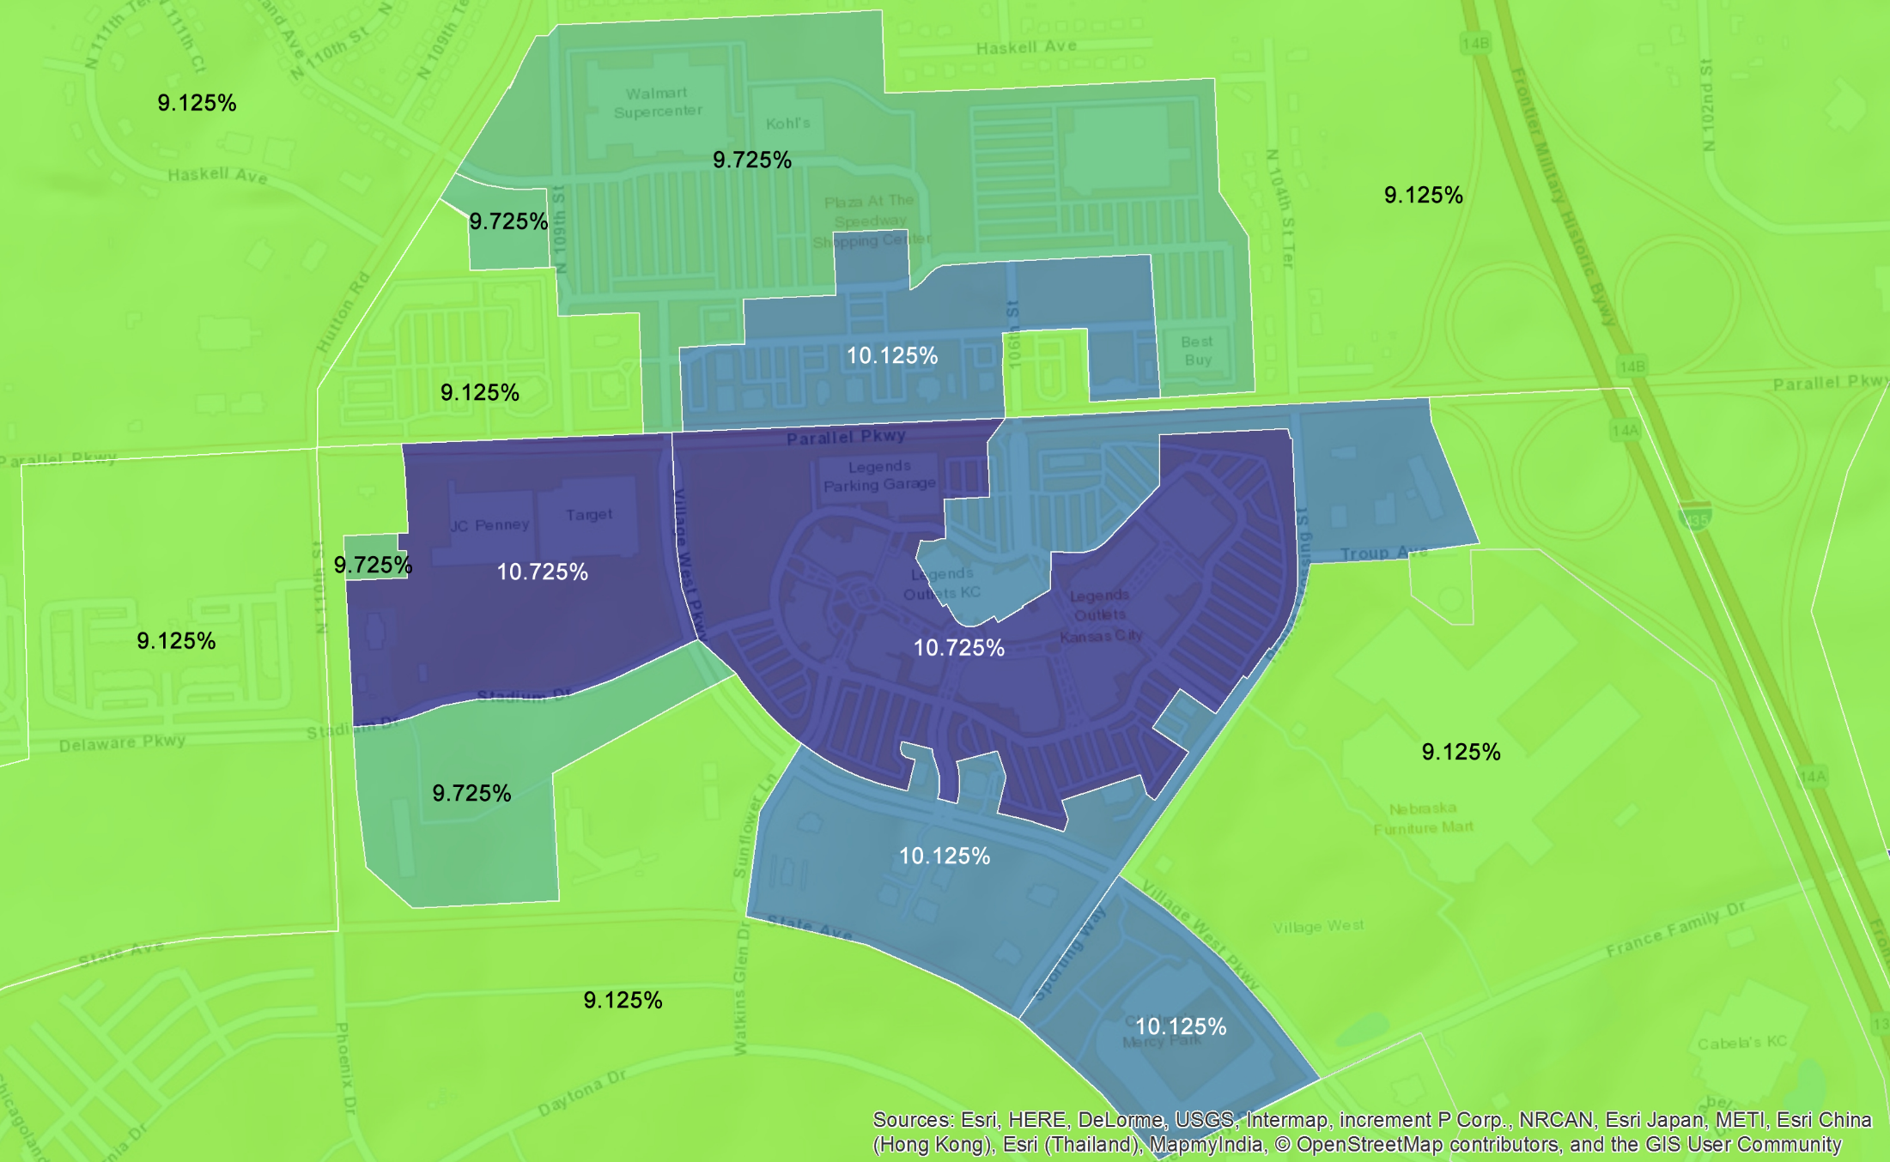
Legends Shopping Area in Wyandotte County
has varying tax rates. The sales tax rate at the Wal-Mart
is 9.73%, Target is 10.725%, and Nebraska Furniture Mart
is 9.125%. These invisible boundaries leave the
consumer blindly navigating the retail market environment.

Slide 67
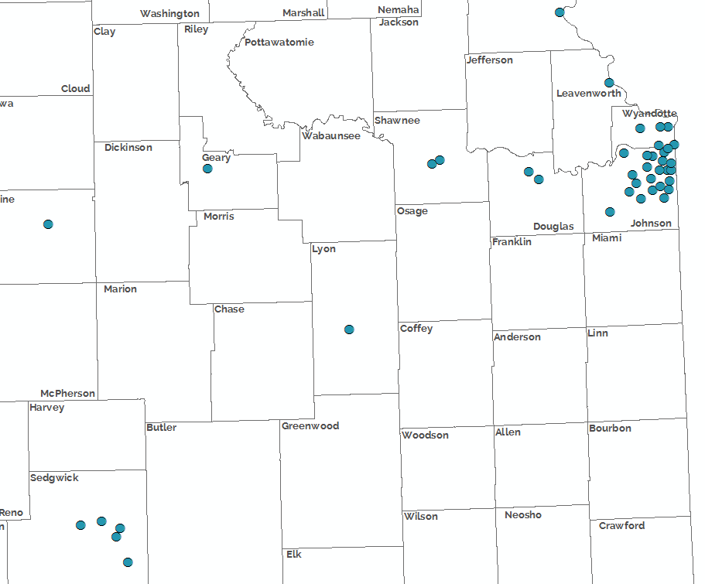
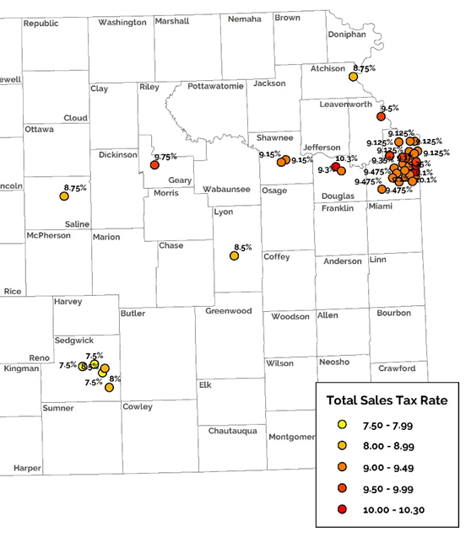
Sales Tax Disparities in Kansas
This map shows a major chain store with many locations in Kansas. However, stores are in different sales tax areas ranging from 7.5 percent to 10.3 percent.
While the difference in the total purchase price of one gallon of milk may only be 7 cents, for the average family of four spending a modest $1,000 per month on groceries this could mean an extra $336 a year.
U.S. Department of Agriculture. (2019). Official USDA Food Plans: Cost of Food at Home at Four Levels, U.S. Average, July 2019. Washington, D.C.: USDA Center for Nutrition Policy and Promotion. Retrieved September 24, 2019, https://www.fns.usda.gov/sites/default/files/media/file/CostofFoodJul2019.pdf

Slide 68
Let’s Get Started: Sales Taxes!
Sales taxes in the state are incredibly complicated
Not low-lying fruit
Wayfair is an important first step
What about the sales tax base?
Food sales tax?
We have a lot to talk about!

Slide 69
Questions?

