Slide 1
History & Current Status of Economic Development in Kansas

Slide 2
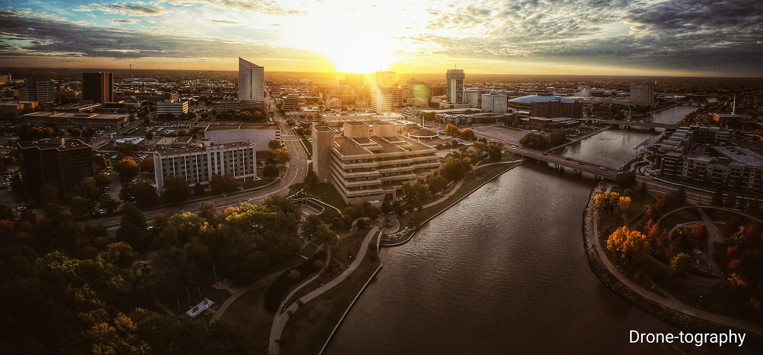
Workforce Development
WHAT DO
WE DO?
Community Development
Business Development
2

Slide 3
Innovation Era
The Downturn
Back to Best in Class
Photo Credit: Kansas Travel & Tourism
3

Slide 4
INNOVATION ERA – 80s & EARLY 00s
Redwood-Krider Report | strategic outcomes
MANUFACTURING & AGRICULTURE
TECH & BIOSCIENCE
TOOLS
• Provided support and resources to encourage growth in the manufacturing and value-added agriculture sectors.
• Kansas Technology Enterprise Corporation (KTEC)
• Kansas Bioscience Authority (KBA)
• STAR Bonds
• Kansas Industrial Training (KIT)
• Kansas Industrial Retraining (KIR)
• Promoting Employment Across Kansas (PEAK)
• High Performance Incentive Program (HPIP)
KANSAS INC.
|
|
4

Slide 5
THE DOWNTURN
BUDGET
SHRINKING
FOOTPRINT
PROGRAM
CUTS
5

Slide 6
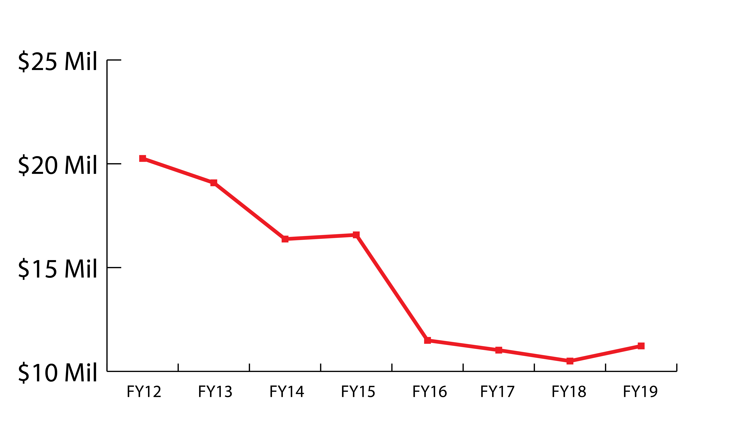
ECONOMIC DEVELOPMENT INITIATIVES FUND
$20 Million Swept Into
State General Fund Annually
6

Slide 7
BUSINESS RECRUITMENT
DOMESTIC
INTERNATIONAL
7

Slide 8
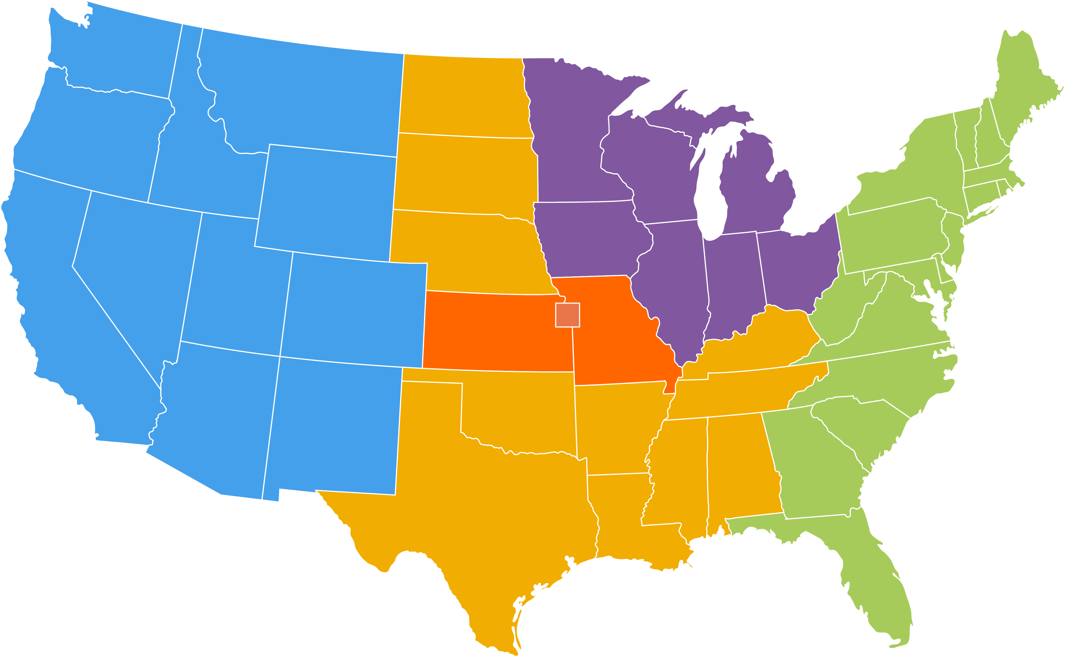
BUSINESS RECRUITMENT
ONE REPRESENTATIVE FOR ENTIRE UNITED STATES
FULL STAFFING LEVEL
WEST COAST REGION
GREAT LAKES REGION
MID-CENTRAL REGION
KANSAS/MISSOURI REGION
EAST COAST REGION
8

Slide 9
INTERNATIONAL BUSINESS RECRUITMENT
FULL STAFFING LEVEL
TWO PEOPLE TO REPRESENT KANSAS INTERNATIONALLY
INTERNATIONAL OFFICES
JAPAN OFFICE - TOKYO
EUROPE OFFICE - LONDON
CHINA OFFICE - BEIJING
MEXICO OFFICE – MEXICO CITY
INTERNATIONAL STRINGERS
KOREA
CHILE
BRAZIL
Kansas
9

Slide 10
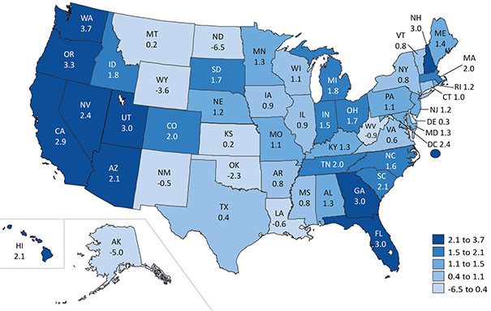
Percent Change in Real GDP by State:
2015-2016
10
U.S. Bureau of Economic Analysis

Slide 11
Getting Back to Best in Class
11

Slide 12
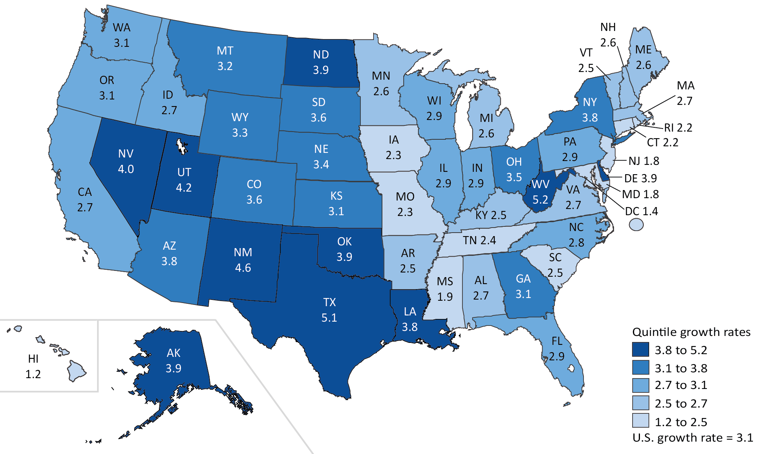
Percent Change in Real GDP by State:
Q4 2018-Q1 2019
12
U.S. Bureau of Economic Analysis

Slide 13
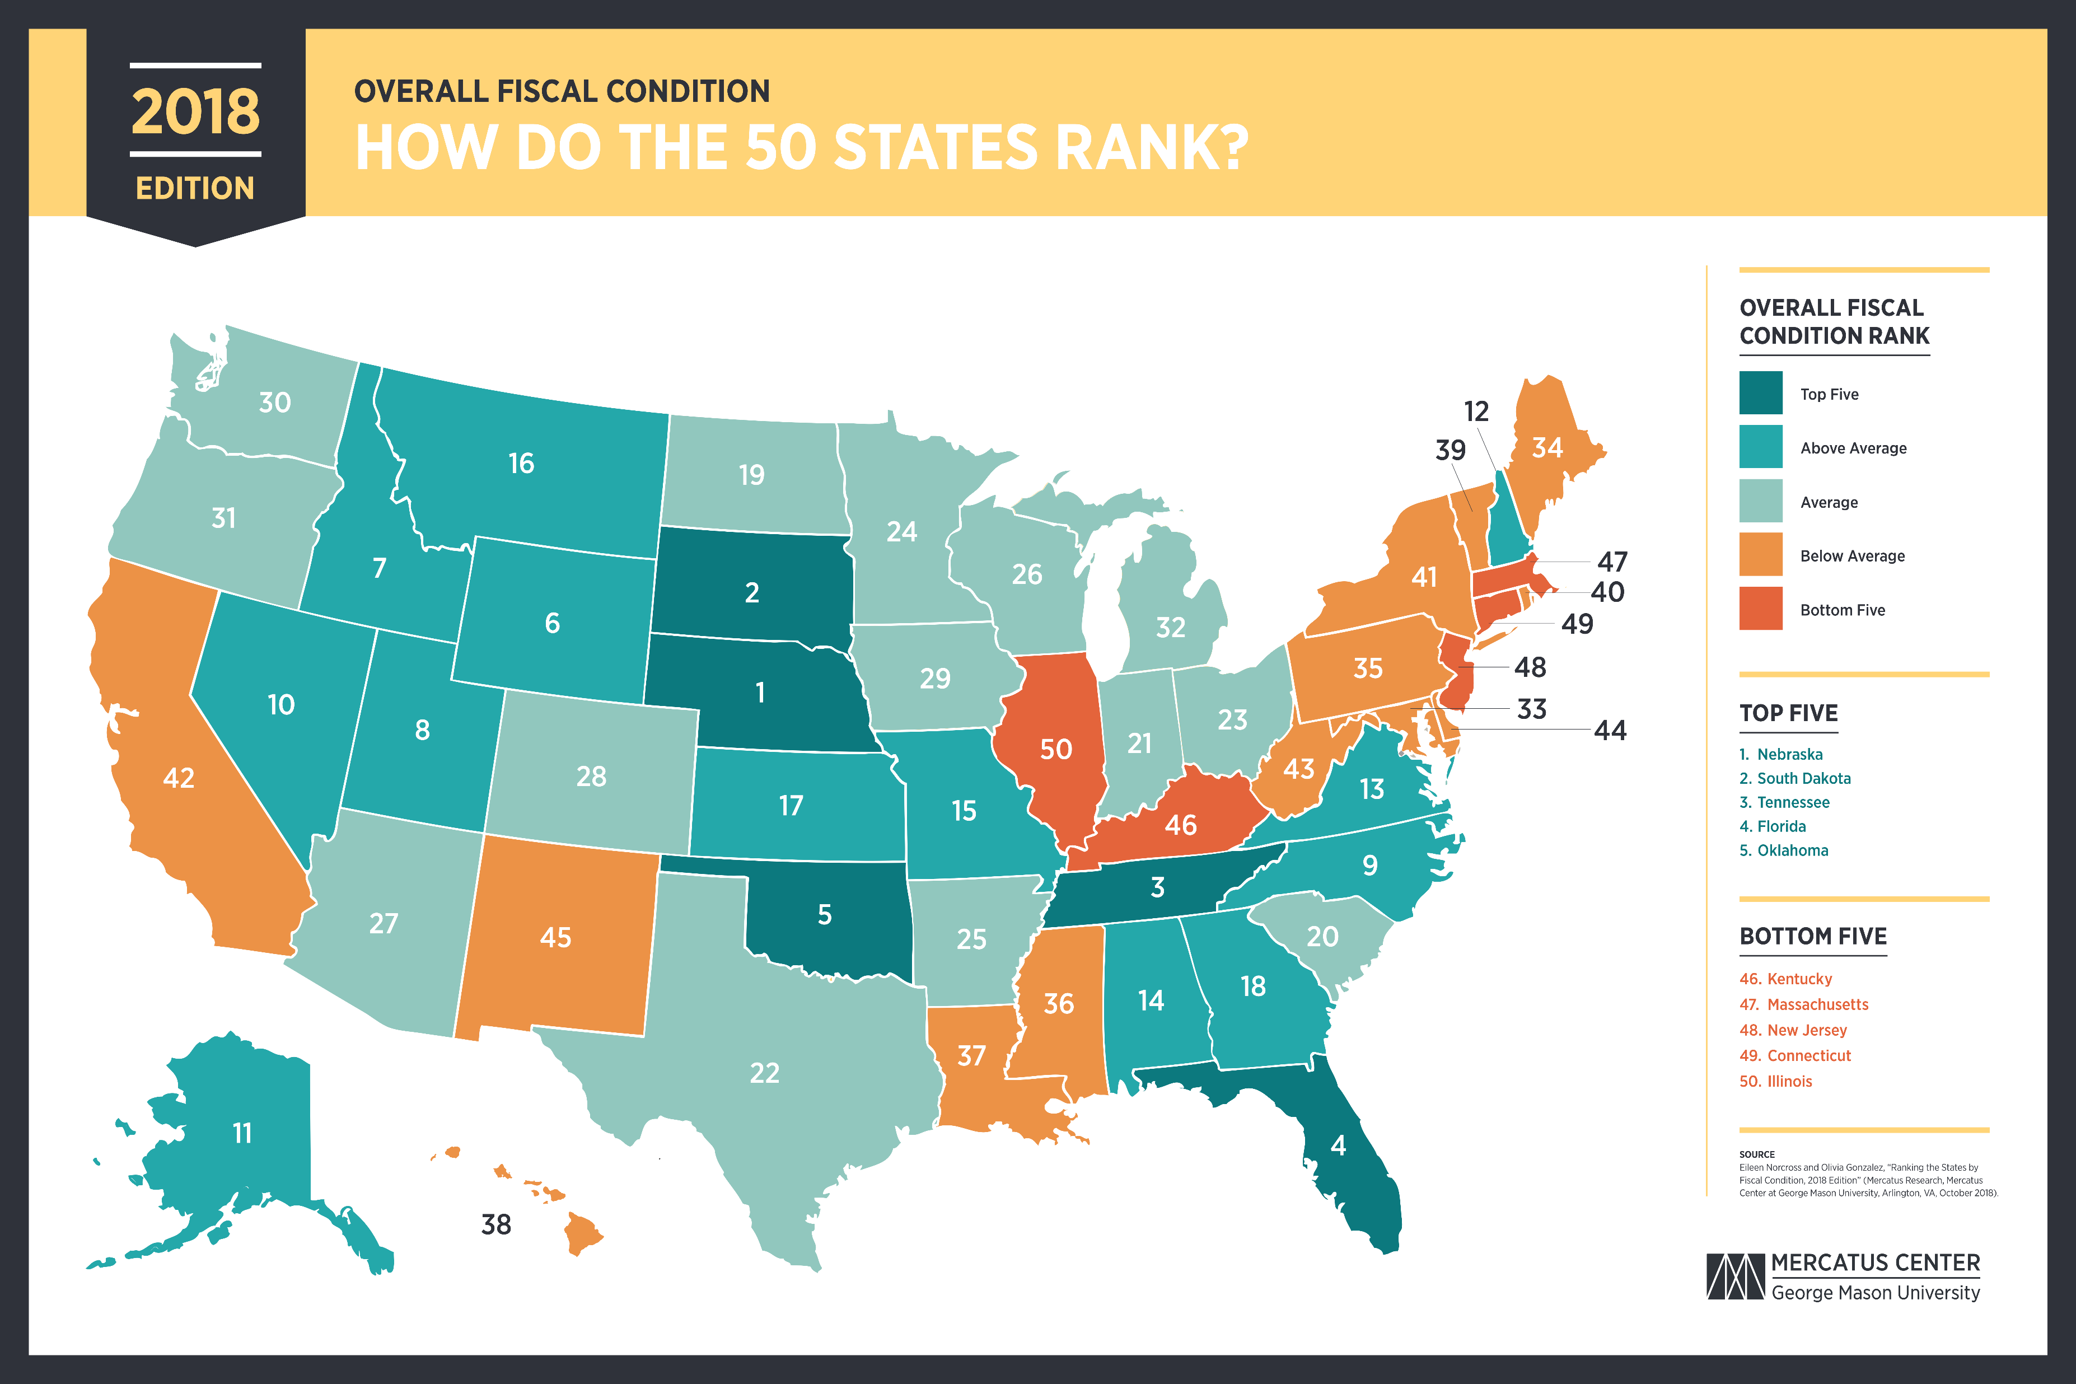
TRENDING
#24
#27
#17
2015 2016 2017
13

Slide 14
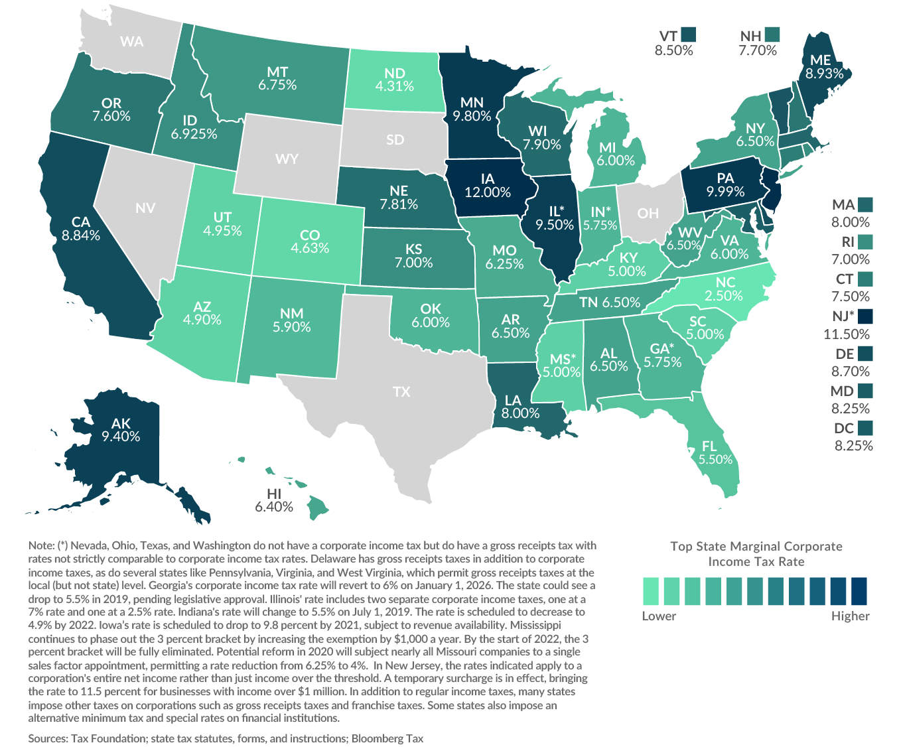
Top Marginal Corporate Income Tax Rates as of January 1, 2019
14

Slide 15
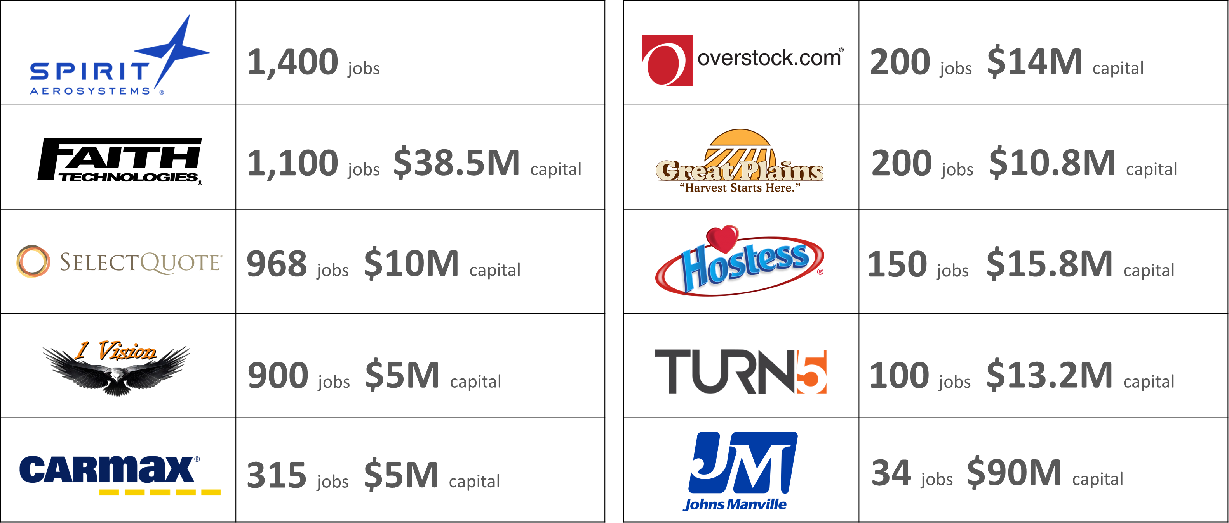
Successful FY19
Department of Commerce incentives, programs and partnerships contributed to 8,682 new jobs and $480M in capital investment.
15

Slide 16
Business Development: YoY Comparisons
Key Measures | FY 2017 Actuals | FY 2018 Actuals | FY 2019 Actuals
Number of jobs created or retained through business development efforts | 10,000 | 19,072 | 25,458
Private capital investment (in billions) in Kansas through Commerce programs | $1.099 | $2.645 | $1.422
Number of projects opened by business development staff | 120 | 140 | 165
Number of jobs created or retained through business recruitment efforts | 7,444 | 7,710 | 8,998
Number of jobs created or retained through retention/expansion efforts | 4,983 | 16,408 | 16,460
Number of face-to-face business contacts through business retention and expansion staff | 987 | 891 | 806
Number of business recruitment projects opened | --- | 79 | 108
Percent of business recruitment projects approved | --- | 42% | 36%
16

Slide 17
GLOBALLY RECOGNIZED COMPANIES
HEADQUARTERED IN KANSAS
17

Slide 18
GLOBALLY RECOGNIZED COMPANIES
OPERATING IN KANSAS
18

Slide 19
Top Industries by GDP in the Private Sector (2017)
19

Slide 20
Industry & Sector Growth Opportunities
Kansas is well-positioned in service industries like transportation, wholesale and retail trade and management of companies.
Transportation machinery manufacturing is a strength for the state.
One opportunity for Kansas is emerging, high-growth advanced manufacturing.
20

Slide 21
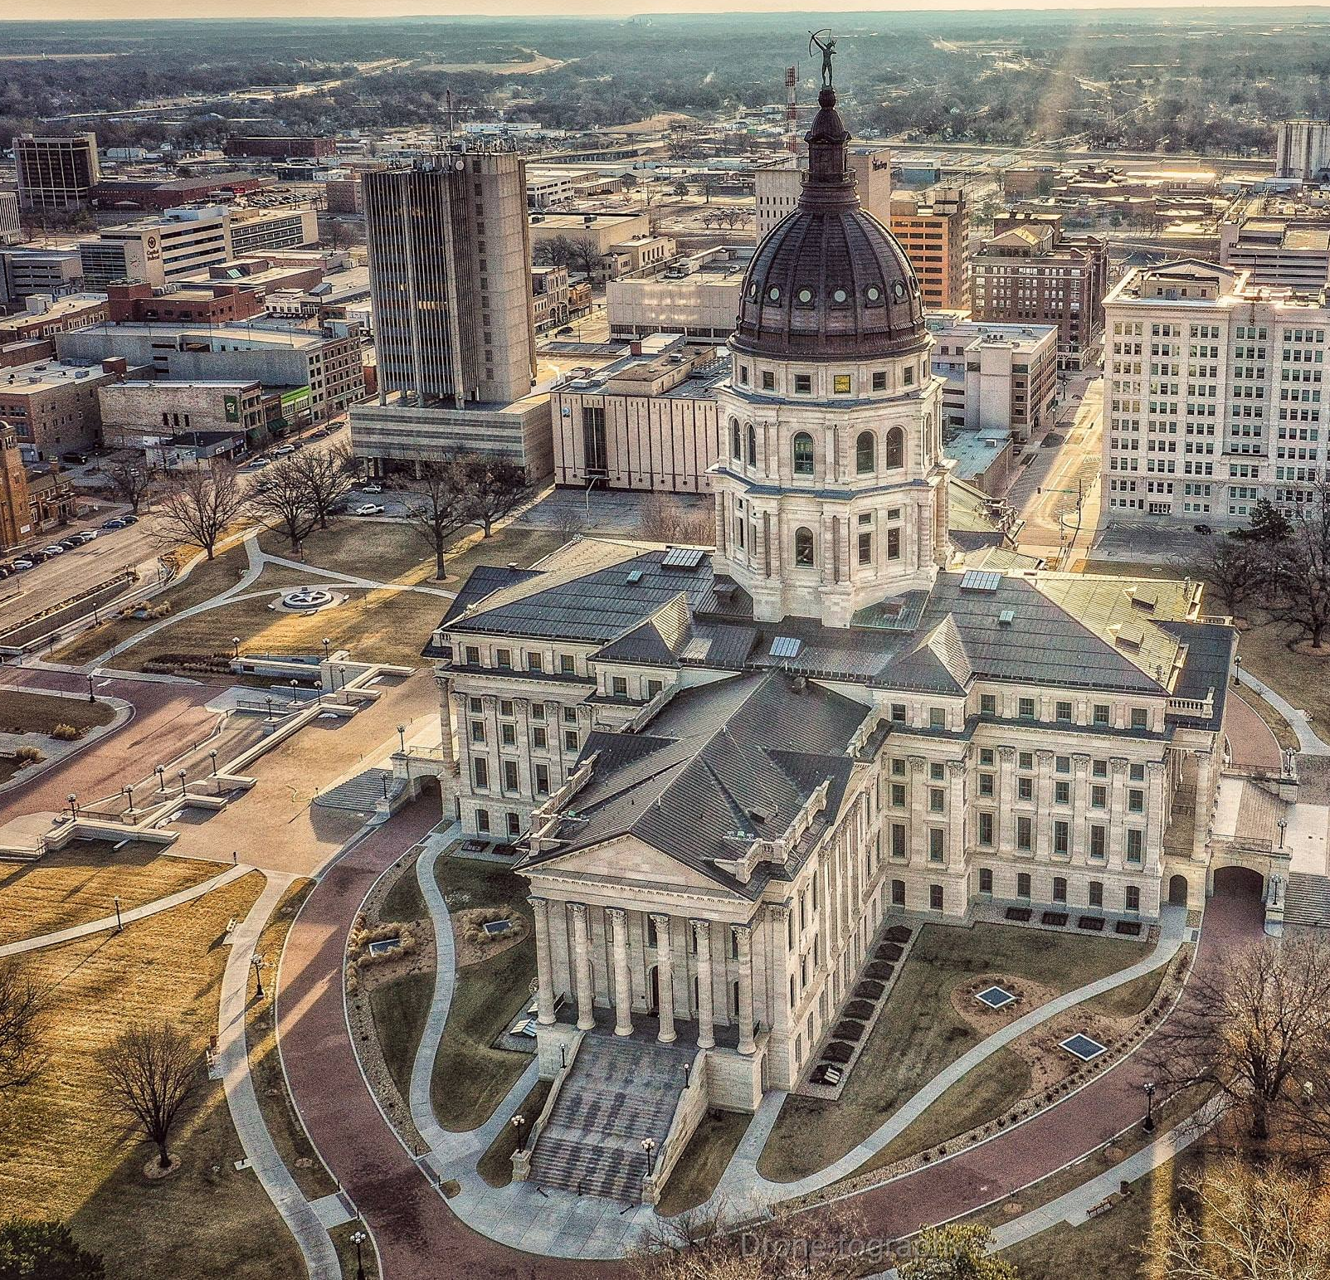
Incentives, Programs & Partnerships that Impact Tax Revenues
21
Photo Credit: Kansas Travel & Tourism

Slide 22
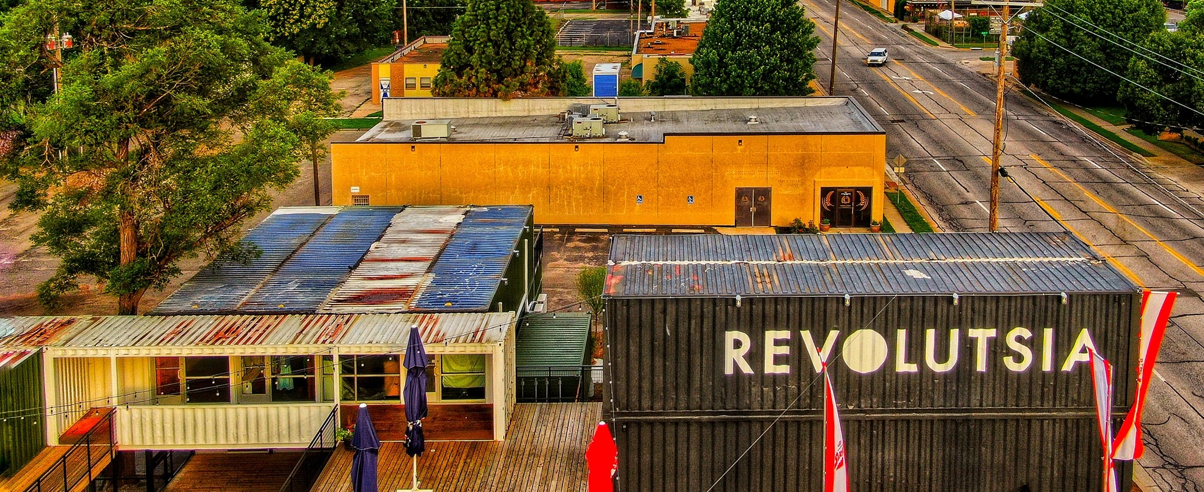
WE’RE NOT WRITING BLANK CHECKS
Nearly all of Commerce’s programs take revenues that don’t yet exist and use them to incentivize growth.
22

Slide 23
INCENTIVES
High-performance Incentive Program (HPIP)
Companies earn tax credit equal to 10% on eligible capital investment.
Tax credit has 16-year life to be utilized.
Threshold investment:
$1M MIN (metro counties)
$50K MIN (non-metro counties)
MUST MEET ELIGIBILITY CRITERIA RELATED TO WAGES & TRAINING INVESTMENT TO QUALIFY, AS WELL AS FALL WITHIN AN ELIGIBLE NAICS CODE OTHER THAN AGRICULTURE, MINING, CONSTRUCTION & RETAIL
~ $550M in unclaimed tax credits: Commerce and Revenue working on a write-down plan of action.
23

Slide 24
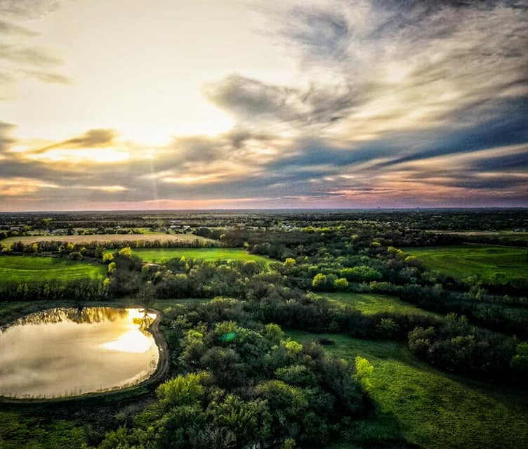
INCENTIVES
Promoting Employment Across Kansas (PEAK)
Companies creating 5-10 new jobs over a 2-year period are eligible.
Median wage must meet or exceed county median wage
Must offer healthcare coverage and pay =/> 50% of premium
Company retains 95% of state withholding on PEAK-eligible jobs. Retention period of withholding up to 10 years depending on total number of jobs created over a 5-year period.
Take Rate for PEAK
2016 56%
2017 54%
2018 47%
2019 YTD* 29%
*With the potential benefit at 63% of total cap. YTD take rate is 19% of total benefit cap.
24

Slide 25
INCENTIVES
STAR Bonds
STAR Bonds are not an obligation of the State – bond holders assume all risk.
Used to develop tourism- and entertainment-based attractions to spur increased tourism and new spending in the state.
Land acquisition, infrastructure and construction costs (in very limited cases).
Must have $50M in capital investment and $50M in annual sales at buildout in metro areas.
Project must be considered to be a major commercial, entertainment or tourism area with regional draw for non-metro areas.
By law, state investment limited to 49% of a project’s total cost.
BONDS ARE REPAID ONLY THROUGH NEW OR INCREASED SALES TAX REVENUE GENERATED WITHIN GEOGRAPHICAL BOUNDARIES OF PROJECT DISTRICT.
25

Slide 26
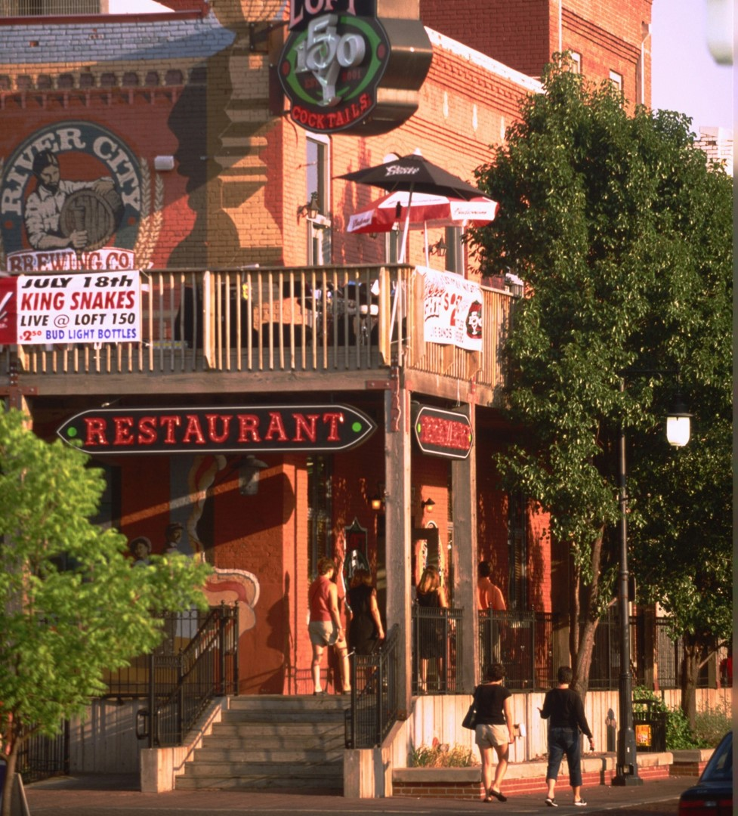
INCENTIVES
Sales Tax Exemption
Available to Kansas businesses via one of two ways
Industrial Revenue Bonds (IRBs).
Sales tax applied to only equipment, materials and labor covered by amount included in revenue bonds.
High Performance Incentive Program (HPIP) – to be certified must meet eligibility criteria.
Certified HPIP companies can receive project exemption from sales tax.
Can be applied toward 100% of equipment, materials and labor.
26

Slide 27
PROGRAMS
Angel Investor Tax Credit Program
Transferrable tax credits offered to eligible start-up businesses producing innovative products or processes.
Company receives tax credits that can be sold to investors to raise funds for business development.
CAP = $6M annually
Community Service Tax Credit Program
Tax credits offered to qualifying community service projects via annual application round.
Awardee projects receive state income tax credits that can be sold to investors.
Value:
50% metro communities
75% rural communities
CAP = $3.5M annually
27

Slide 28
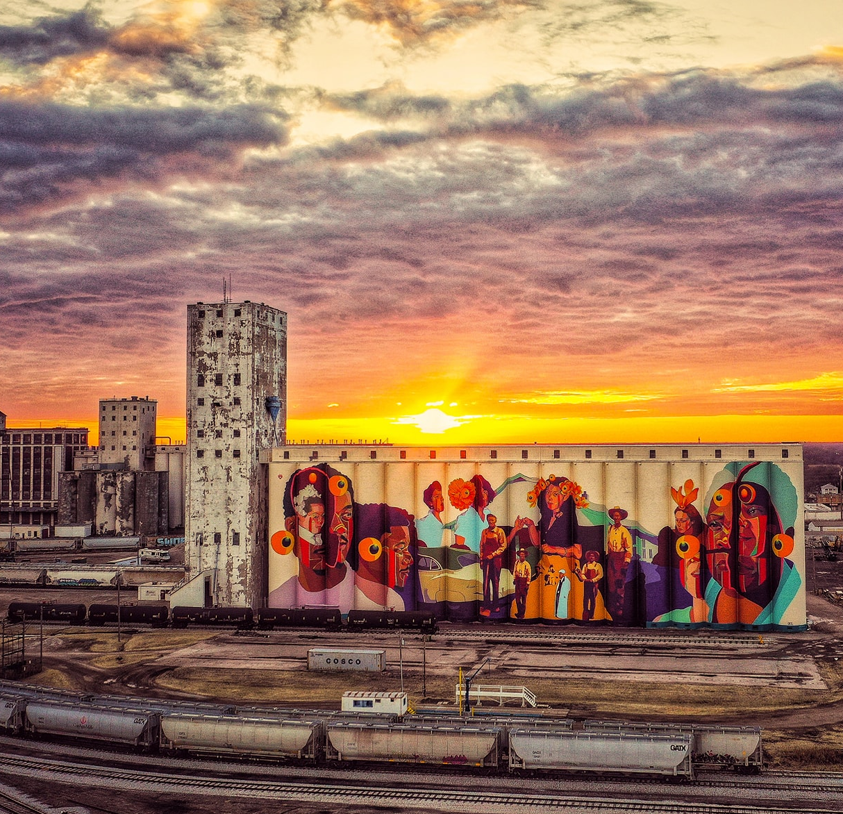
PROGRAMS
Individual Development Account Program
Allows qualified Kansans of low income levels the opportunity to achieve self sufficiency through education and asset development via special savings accounts and higher-income Kansans the opportunity to help others while receiving a 75% income tax credit for the donation to the program.
Eligible for a 2:1 match for every dollar saved.
Savings can be used to:
Purchase a first home
Pay for home repairs
Capitalize a small business
Pay for college or specialized training
Participants must meet income and asset guidelines and complete an online money management course.
CAP = $500K annually
100% of tax credits used over last 3 years
28

Slide 29
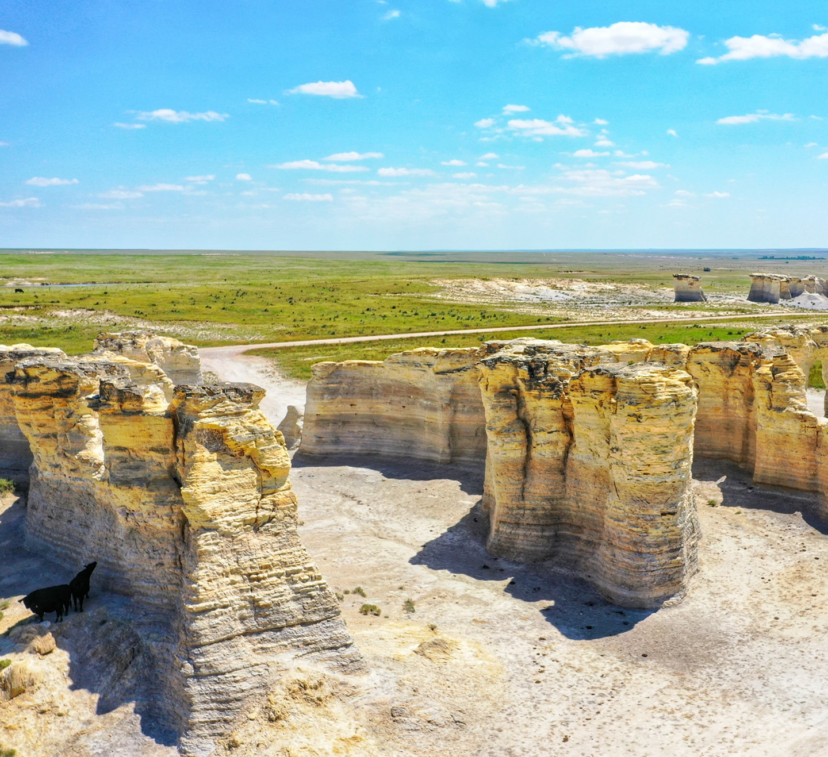
PARTNERSHIPS
NetWork Kansas Entrepreneurship Tax Credit Program
Eligible donors (individuals, financial institutions, corporations) receive a 75% state income tax credit for their donation to NetWork Kansas Entrepreneurship Fund.
Tax credit allowed:
MIN $187.50 ($250 donation)
MAX $100,000 ($133.3K donation)
Tax credits may be carried forward until total amount of tax credit is applied.
The Fund created by the tax credits is used to help create revolving loan funds in NetWork Kansas’ 57 e-communities, support entrepreneurship and provide matching loans through local and regional partners such as regional development organizations and certified development companies.
29

Slide 30
Shaping the Future
Rebuilding the Department of Commerce
New strategic plan for economic development
Diversification of Kansas economy – by industry AND geography
30

Slide 31
THANK YOU
Monthly Newsletter
www.KansasCommerce.gov/SignUp
/KansasCommerce
/KANSASWORKS
/company/Kansas- Department-of-Commerce
@SecretaryToland
@KansasCommerce
@KansasWorkforce
/KansasCommerce
/KansasCommerce

